Slide 1
Summary
Uncertainties in measurement
Mass fraction calculation options
Recalculations using new wt% and Ice cp measurements
Comparisons with SeaFreeze EOS and Tillner-Roth & Friend’s EOS
NH₃ EOS errors of rho and cp w.r.t T and m
Periodicity in melting phase
ADH double peaks

Slide 2
Questions
Ice Cp: are we concerned with the difference between
0.25 K/min and 0.1 K/min
Our experiment and Feistel and Wagner
0.1 K/min variability at the start and in the middle
Mass Fraction Determination: if based on measurements
Density is inconsistent:

Slide 3
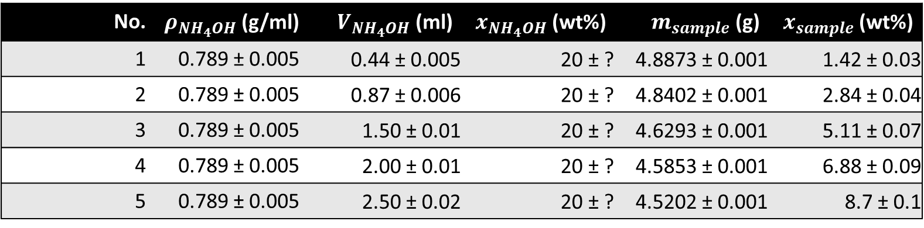
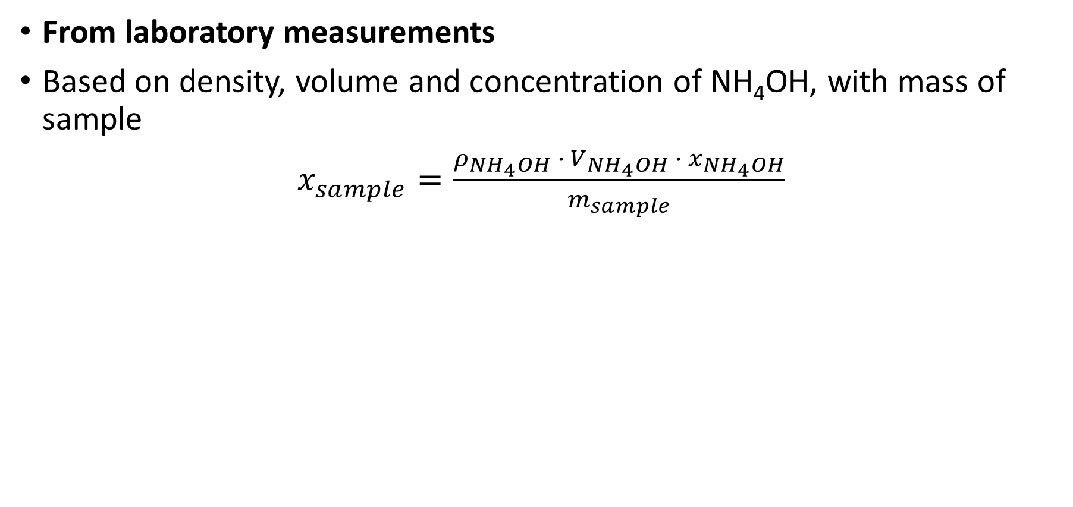
Mass fraction calculation option 1
From laboratory measurements
Based on density, volume and concentration of NH₄OH, with mass of sample
$x_{sample}=\frac{ρ_{{NH}_{4}OH} ∙ V_{{NH}_{4}OH} ∙{ x}_{{NH}_{4}OH}}{m_{sample}}$
No. | $ρ_{{NH}_{4}OH}$(g/ml) | $V_{{NH}_{4}OH}$ (ml) | ${ x}_{{NH}_{4}OH}$ (wt%) | $m_{sample}$ (g) | $x_{sample}$ (wt%)
1 | 0.789 ± 0.005 | 0.44 ± 0.005 | 20 ± ? | 4.8873 ± 0.001 | 1.42 ± 0.03
2 | 0.789 ± 0.005 | 0.87 ± 0.006 | 20 ± ? | 4.8402 ± 0.001 | 2.84 ± 0.04
3 | 0.789 ± 0.005 | 1.50 ± 0.01 | 20 ± ? | 4.6293 ± 0.001 | 5.11 ± 0.07
4 | 0.789 ± 0.005 | 2.00 ± 0.01 | 20 ± ? | 4.5853 ± 0.001 | 6.88 ± 0.09
5 | 0.789 ± 0.005 | 2.50 ± 0.02 | 20 ± ? | 4.5202 ± 0.001 | 8.7 ± 0.1

Slide 4
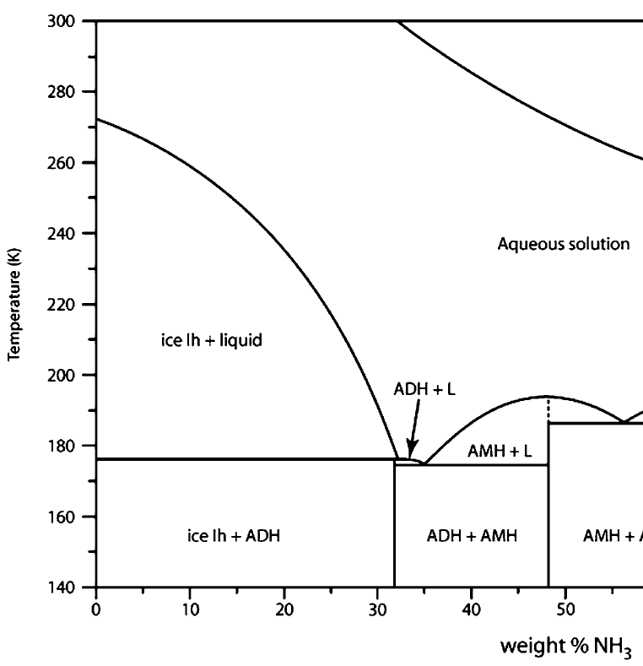
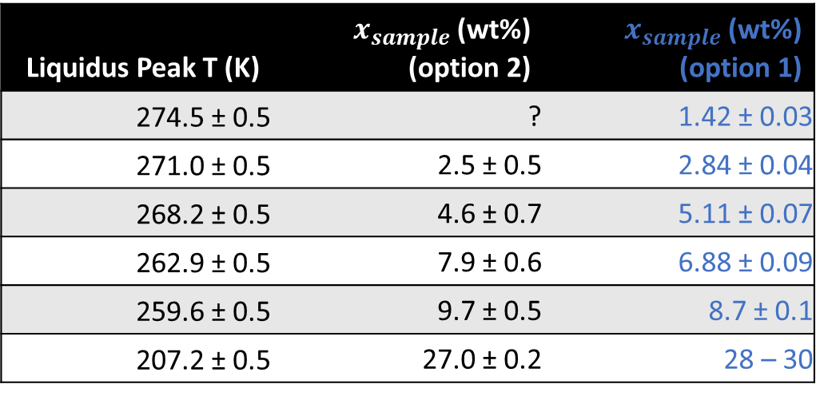
Mass fraction calculation option 2
From using the temperature of the measured liquidus peak to determine theoretical mass fraction via the liquidus curve
Liquidus Peak T (K) | $x_{sample}$ (wt%) (option 2) | $x_{sample}$ (wt%) (option 1)
274.5 ± 0.5 | ? | 1.42 ± 0.03
271.0 ± 0.5 | 2.5 ± 0.5 | 2.84 ± 0.04
268.2 ± 0.5 | 4.6 ± 0.7 | 5.11 ± 0.07
262.9 ± 0.5 | 7.9 ± 0.6 | 6.88 ± 0.09
259.6 ± 0.5 | 9.7 ± 0.5 | 8.7 ± 0.1
207.2 ± 0.5 | 27.0 ± 0.2 | 28 – 30

Slide 5
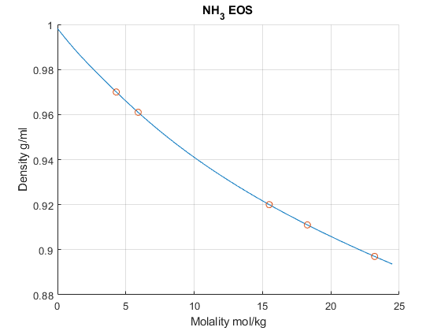
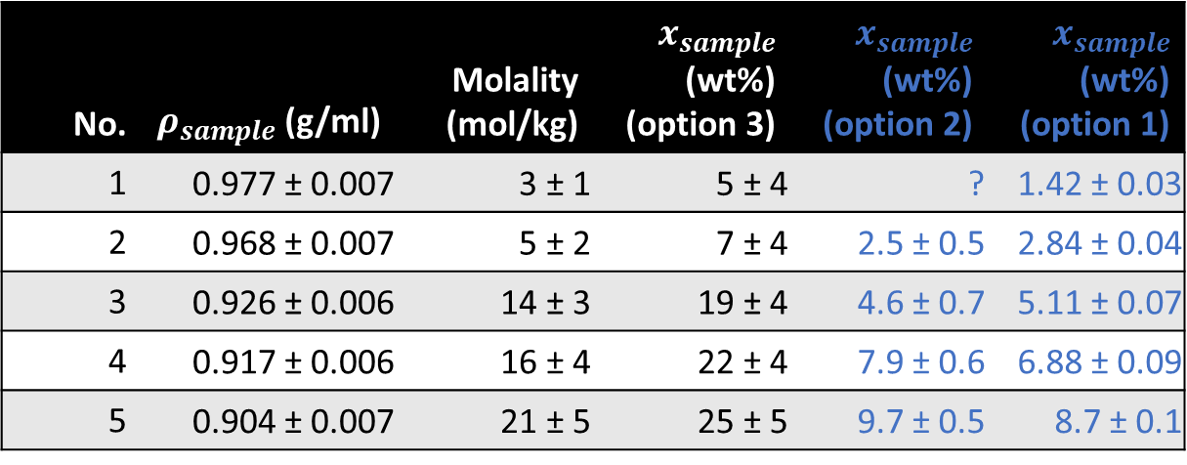
Mass fraction calculation option 3
From NH₃ EOS, extract mass fraction based on density of sample
Assumed measurements done at 25°C
No. | $ρ_{sample}$(g/ml) | Molality (mol/kg) | $x_{sample}$ (wt%) (option 3) | $x_{sample}$ (wt%) (option 2) | $x_{sample}$ (wt%) (option 1)
1 | 0.977 ± 0.007 | 3 ± 1 | 5 ± 4 | ? | 1.42 ± 0.03
2 | 0.968 ± 0.007 | 5 ± 2 | 7 ± 4 | 2.5 ± 0.5 | 2.84 ± 0.04
3 | 0.926 ± 0.006 | 14 ± 3 | 19 ± 4 | 4.6 ± 0.7 | 5.11 ± 0.07
4 | 0.917 ± 0.006 | 16 ± 4 | 22 ± 4 | 7.9 ± 0.6 | 6.88 ± 0.09
5 | 0.904 ± 0.007 | 21 ± 5 | 25 ± 5 | 9.7 ± 0.5 | 8.7 ± 0.1
Is m in PTm inputs for SeaFreeze ‘molality’?

Slide 6
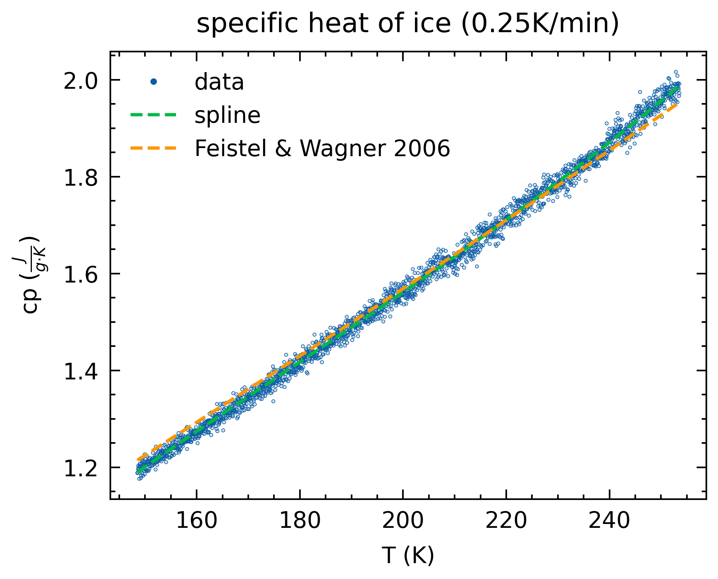
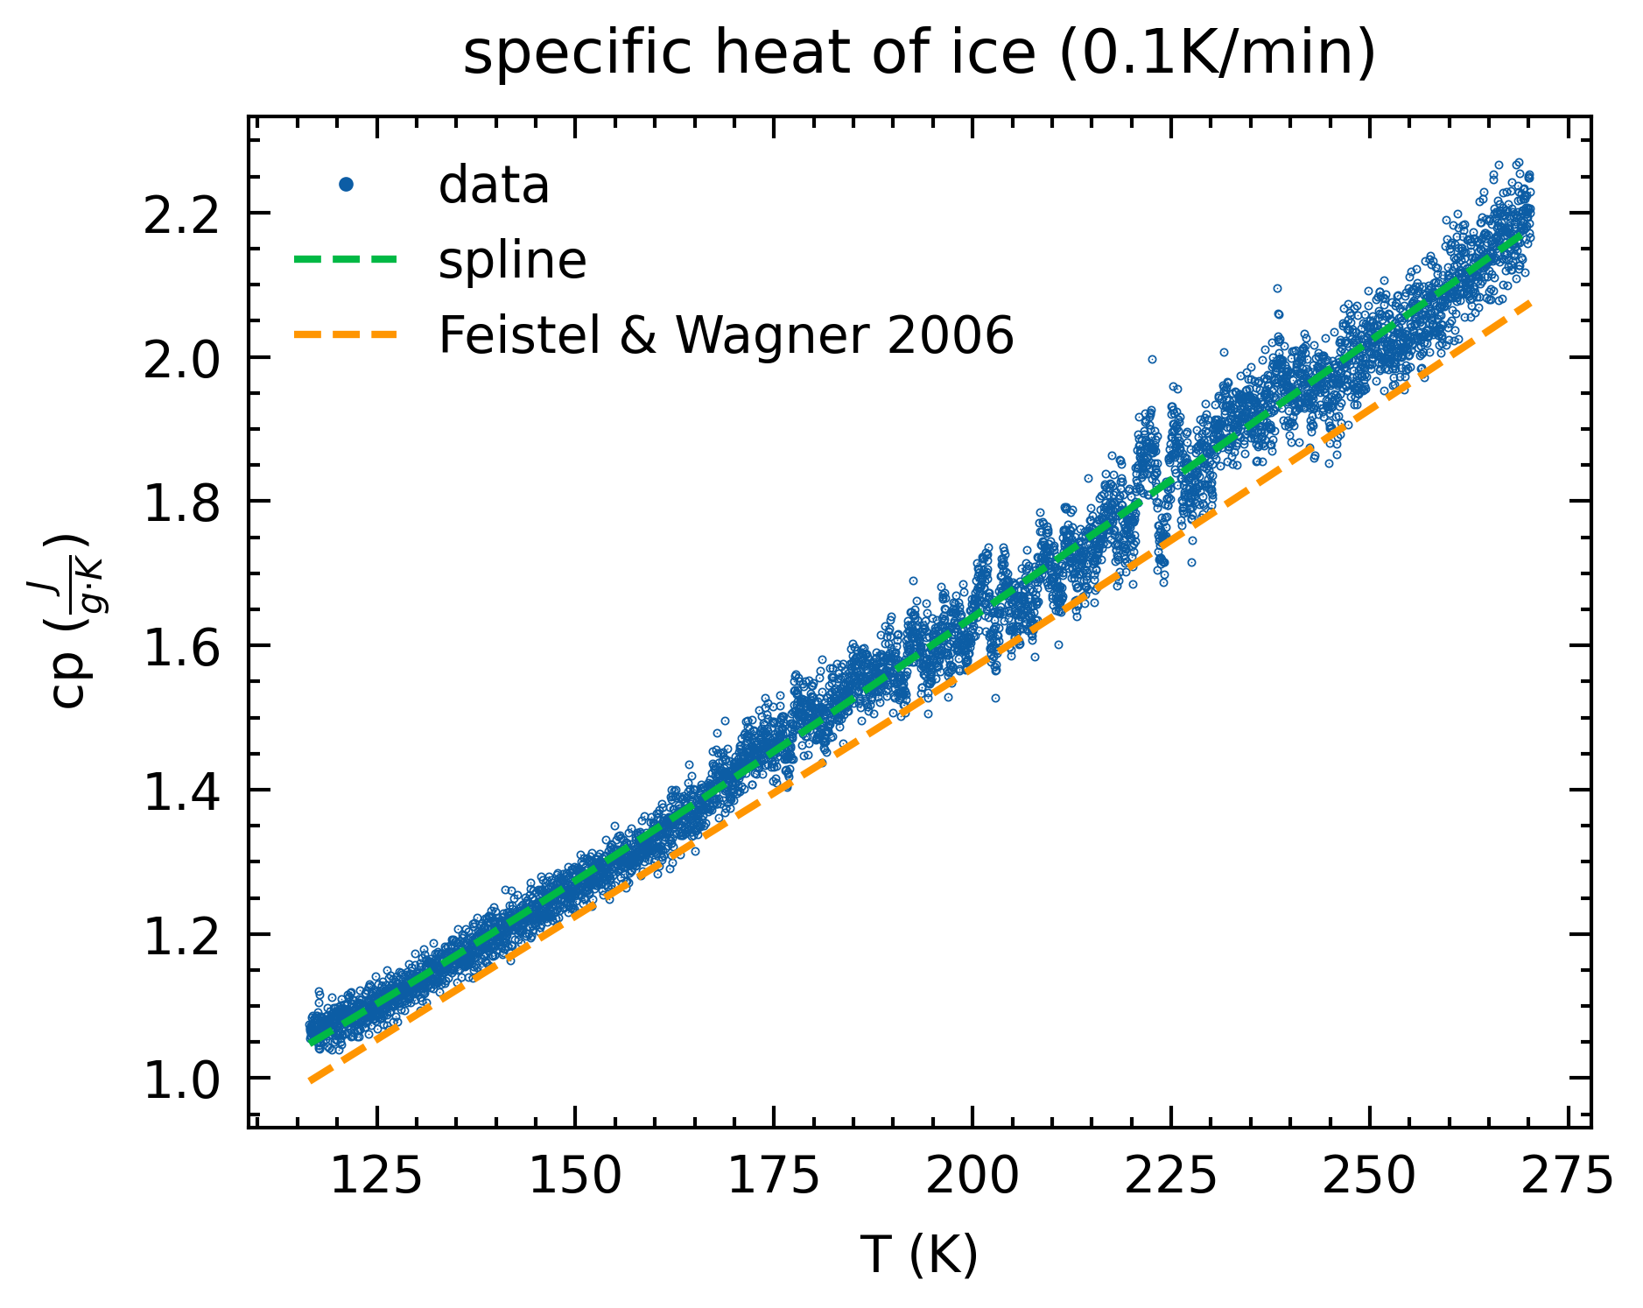
Ice specific heat

Slide 7
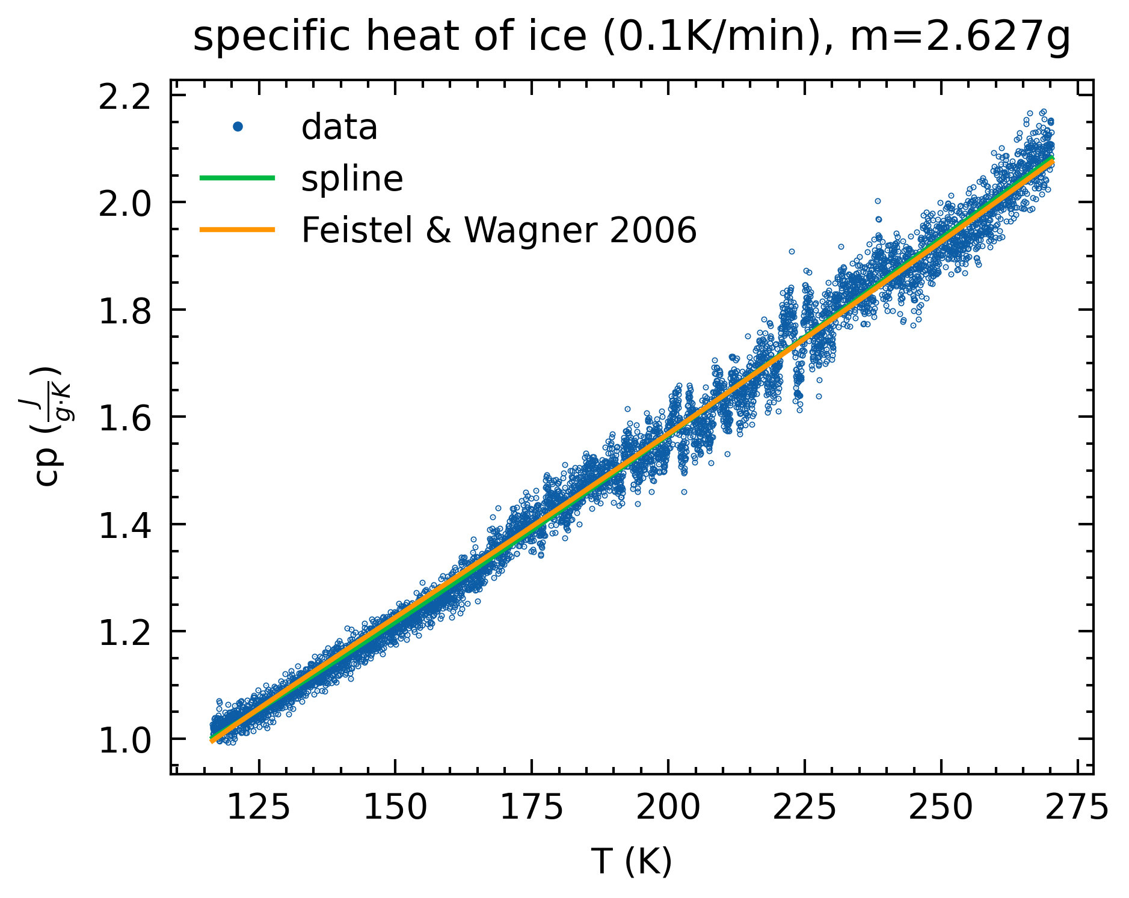
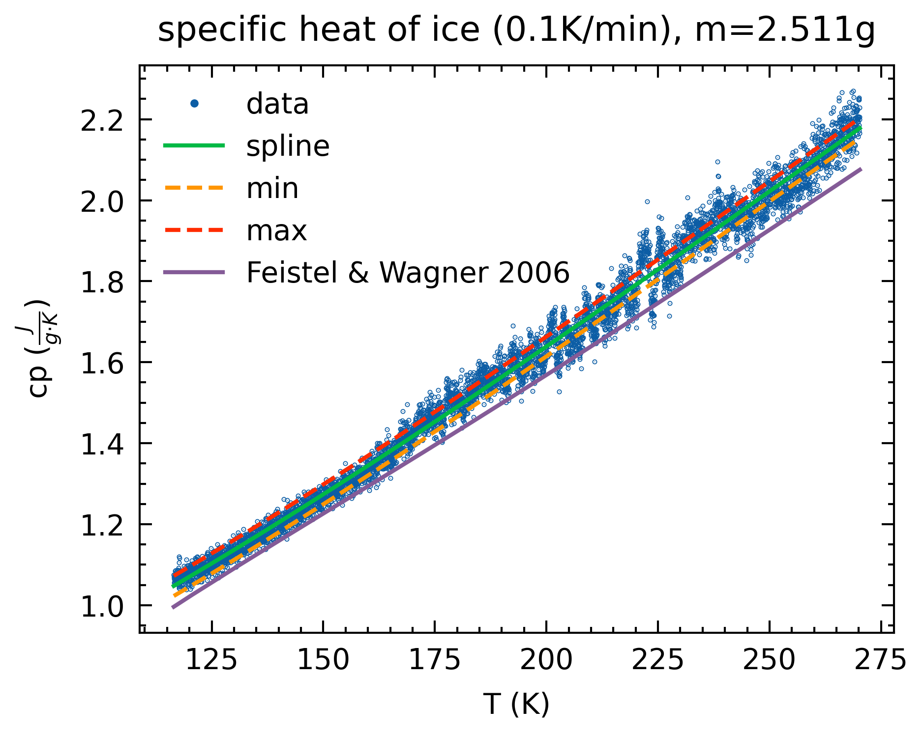
Ice specific heat
Change mass to fit literature ~0.1g (scale mass uncertainty 0.001g)
Propagated uncertainty, literature still falls outside

Slide 8
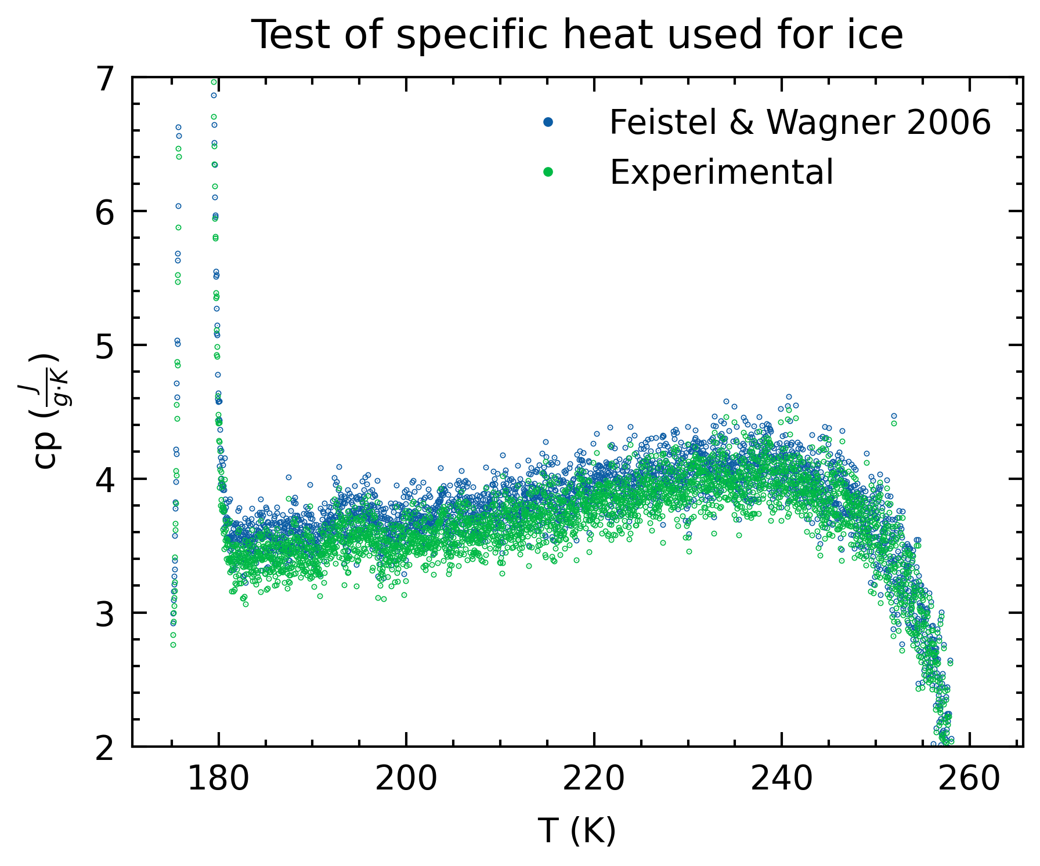
Ice specific heat
Effect of using experimental Ice Cp vs literature
~0.2 lower

Slide 9
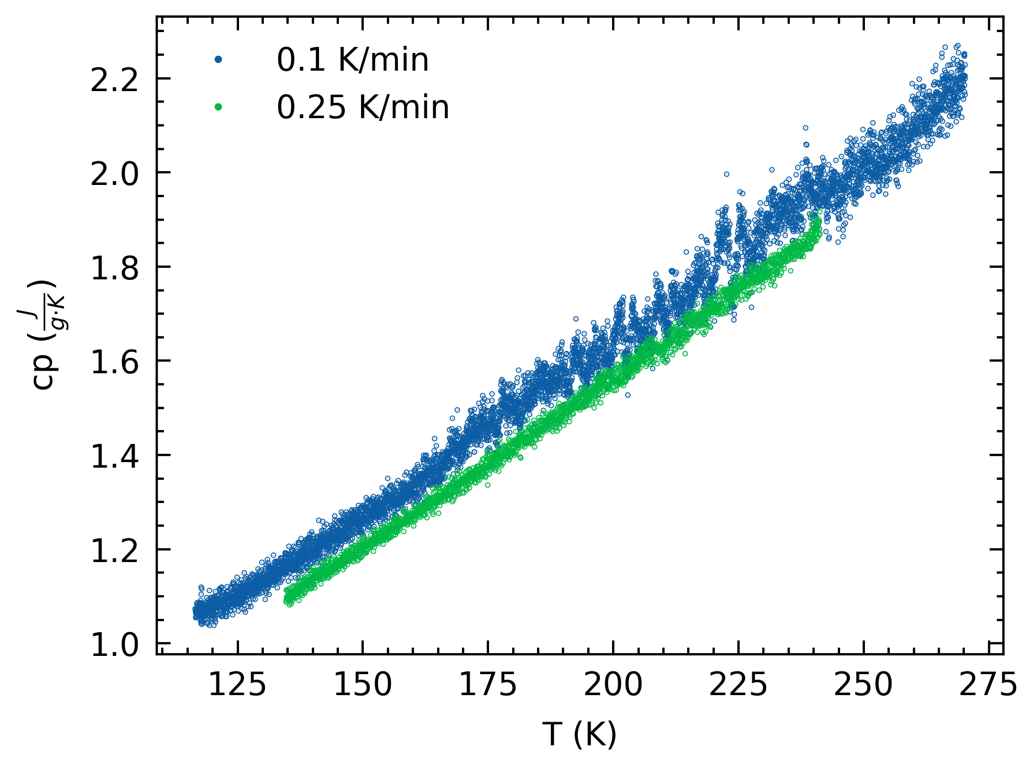
Ice specific heat
Is it concerning that Cp is different between our two experiments?
Is it concerning that for 0.1 K/min, there is an increase in datapoint variability?
A quick thought: check Cp from SeaFreeze

Slide 10
Recalculations
Recalculate Cp using experimental Ice Cp + wt% based on liquidus alignment (option 2)
For the 1st run, 1.42 wt% was still used because liquidus is above 273.15 K.
Reiterate: in melt phase, the mass fraction of the liquid at the same Temperature is theoretically equal across all samples. Hence we should be expecting same/similar specific heat values.

Slide 11
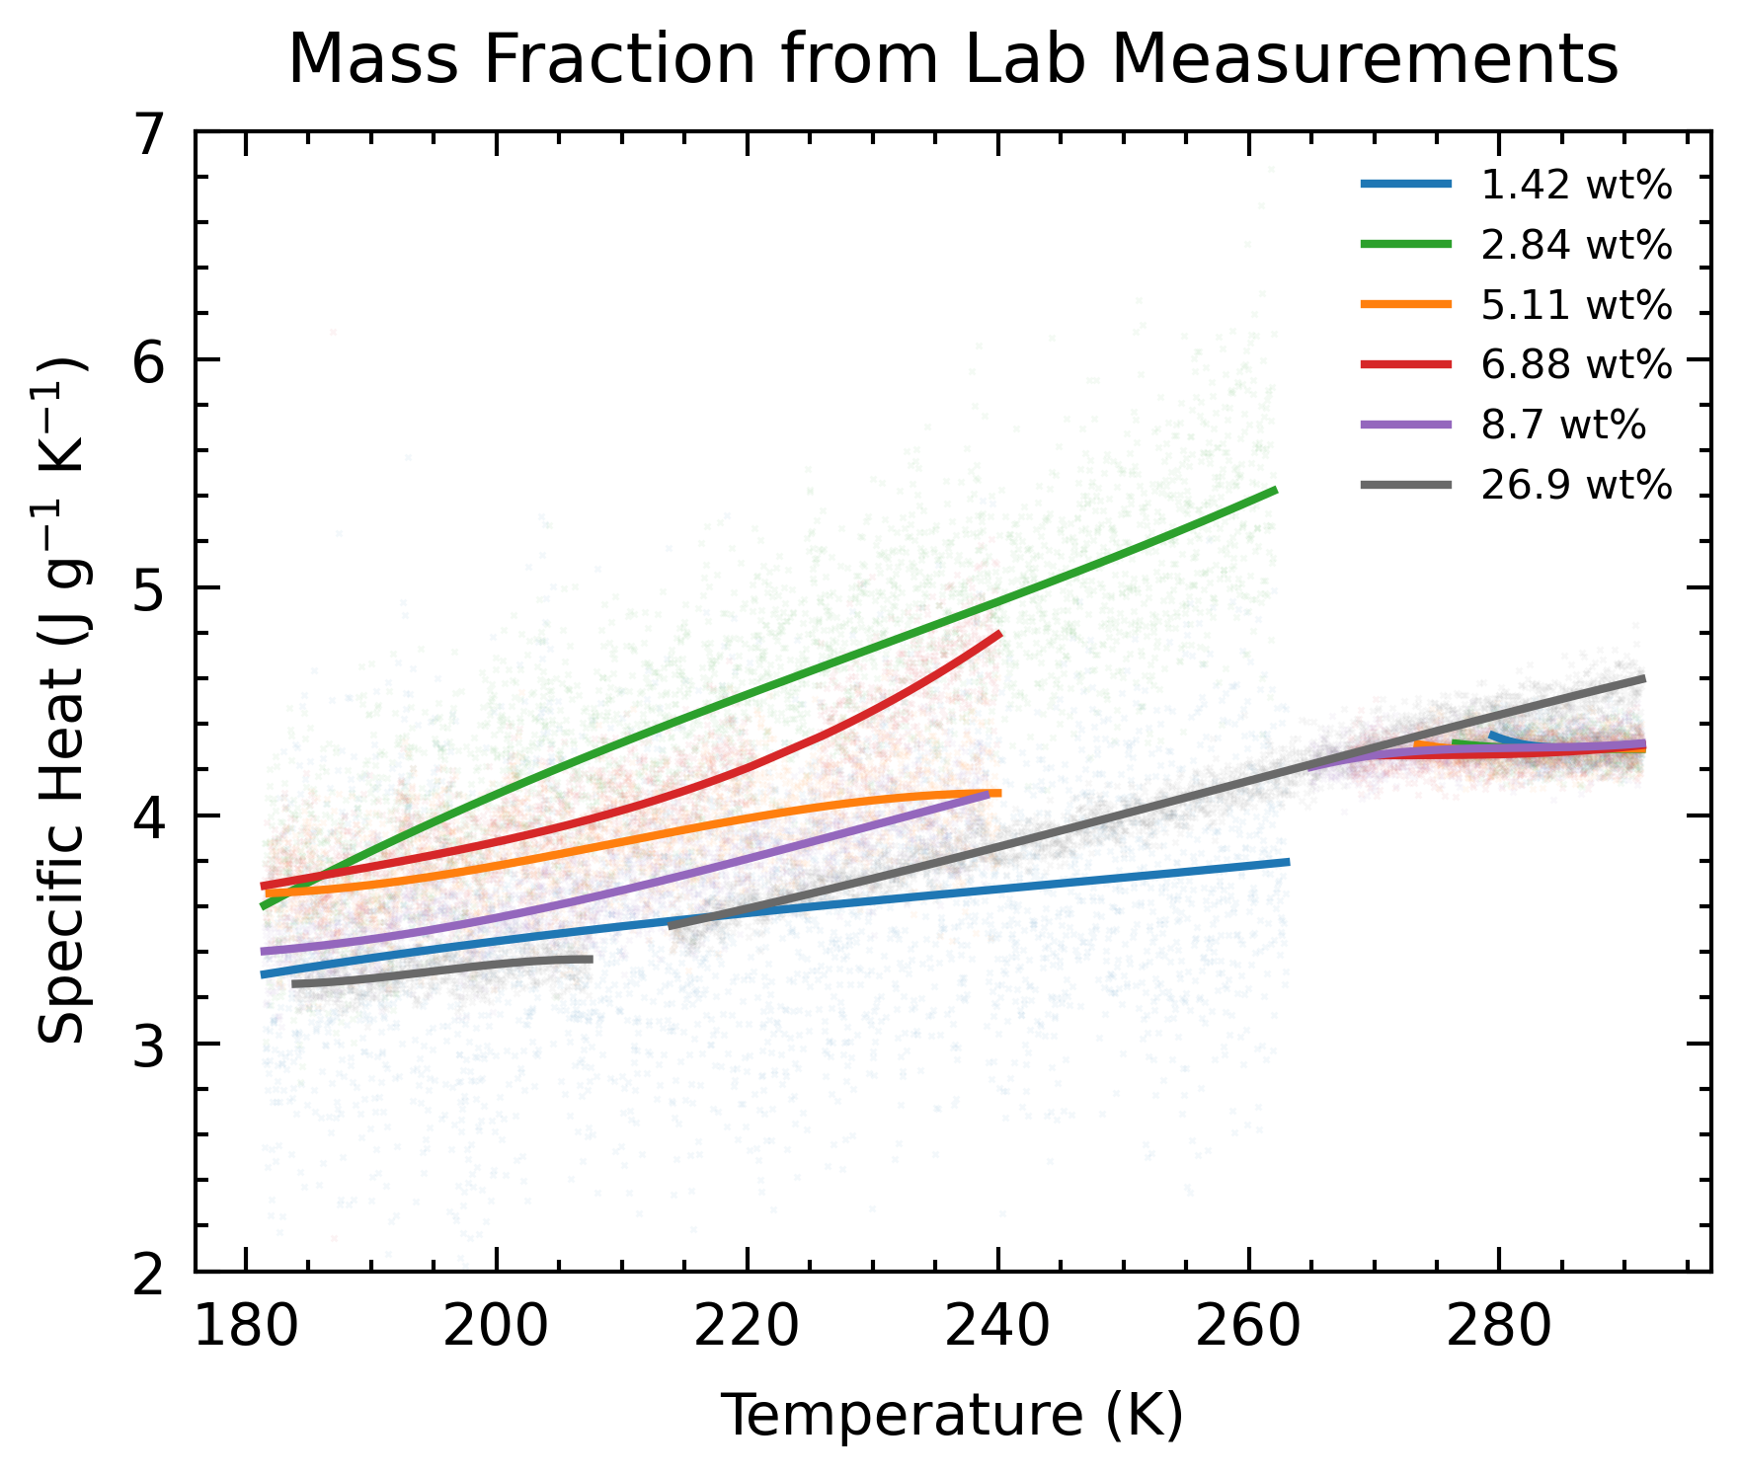
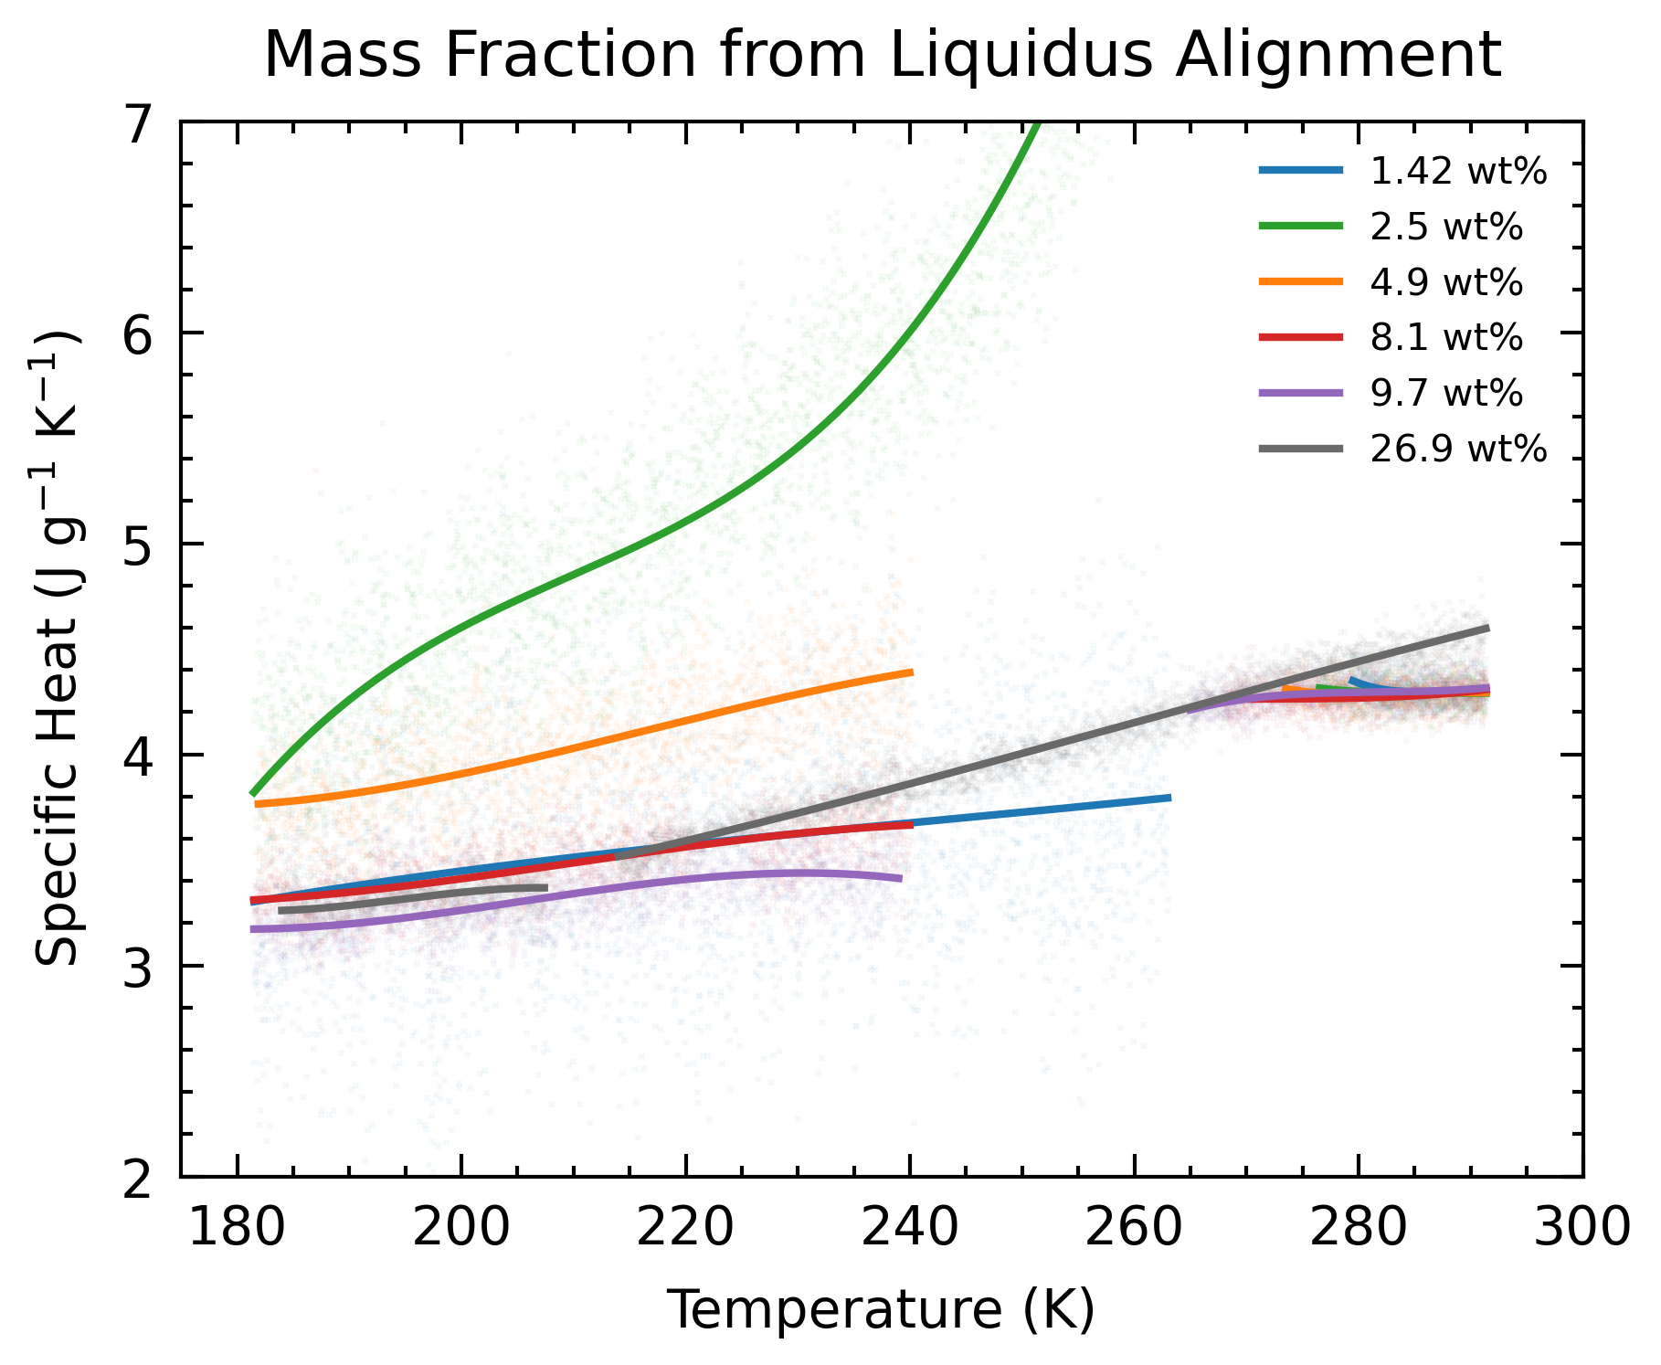
Recalculations
Convergence of data (somewhat?)

Slide 12
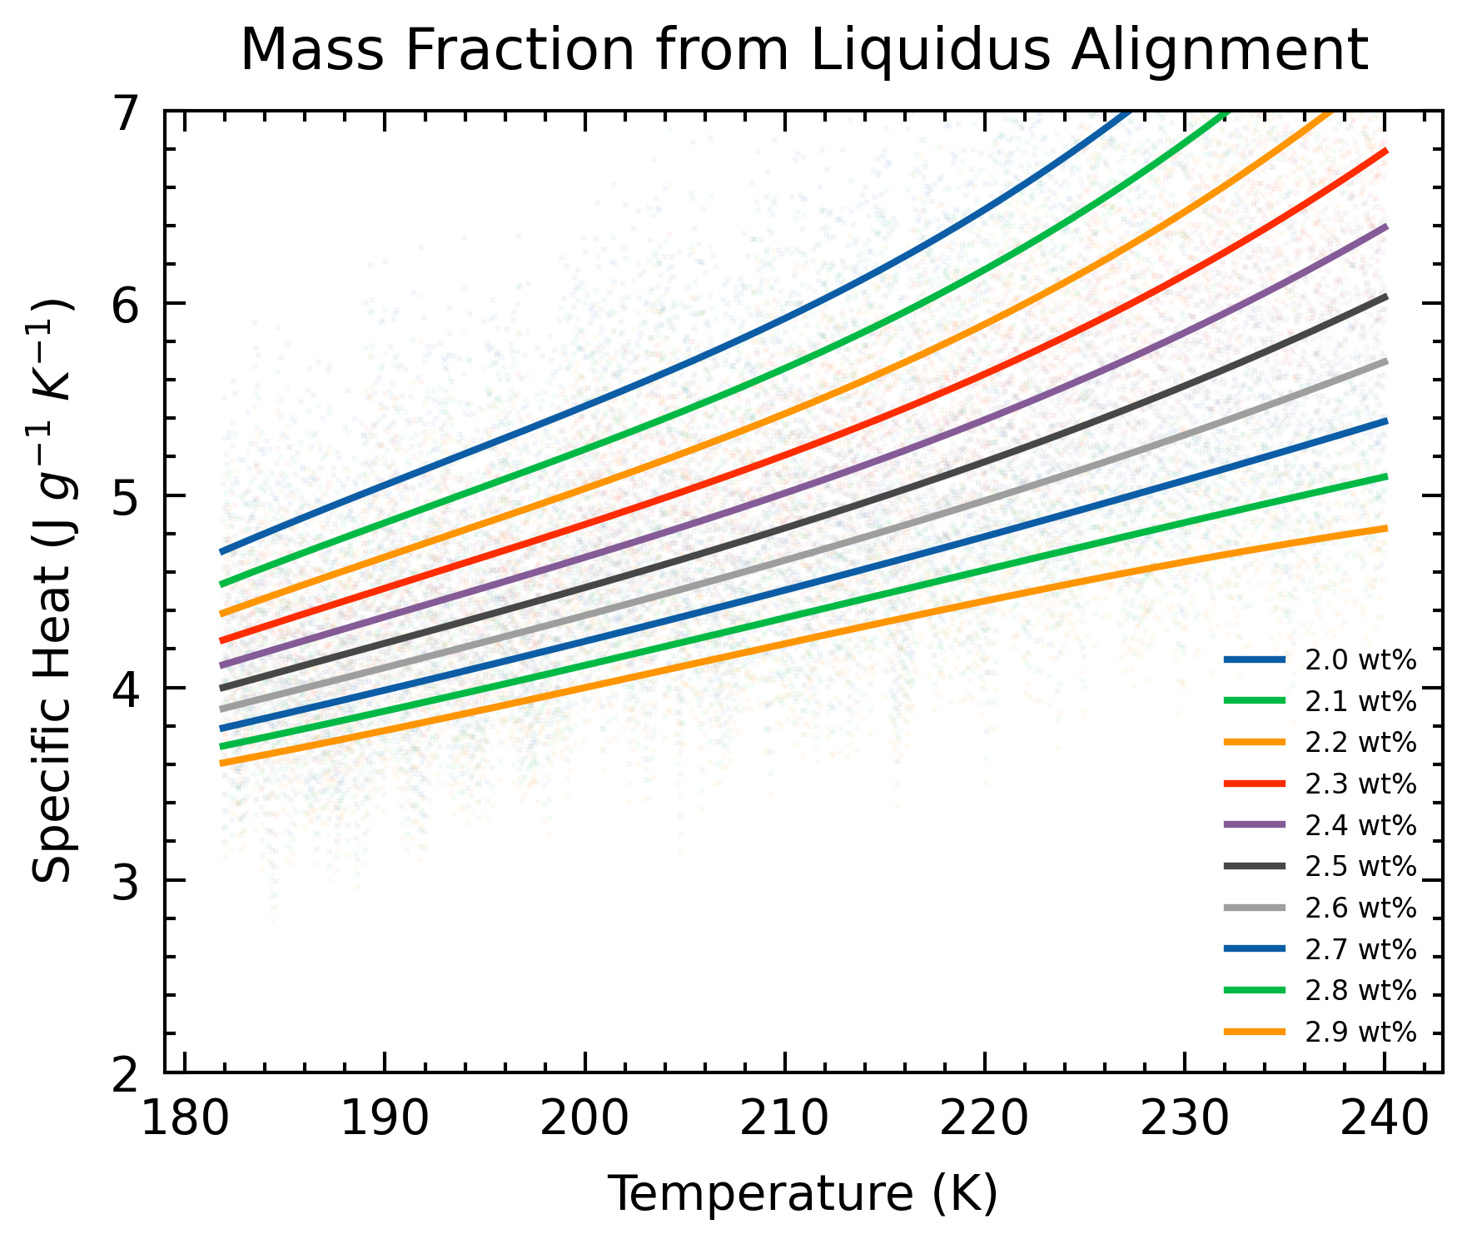
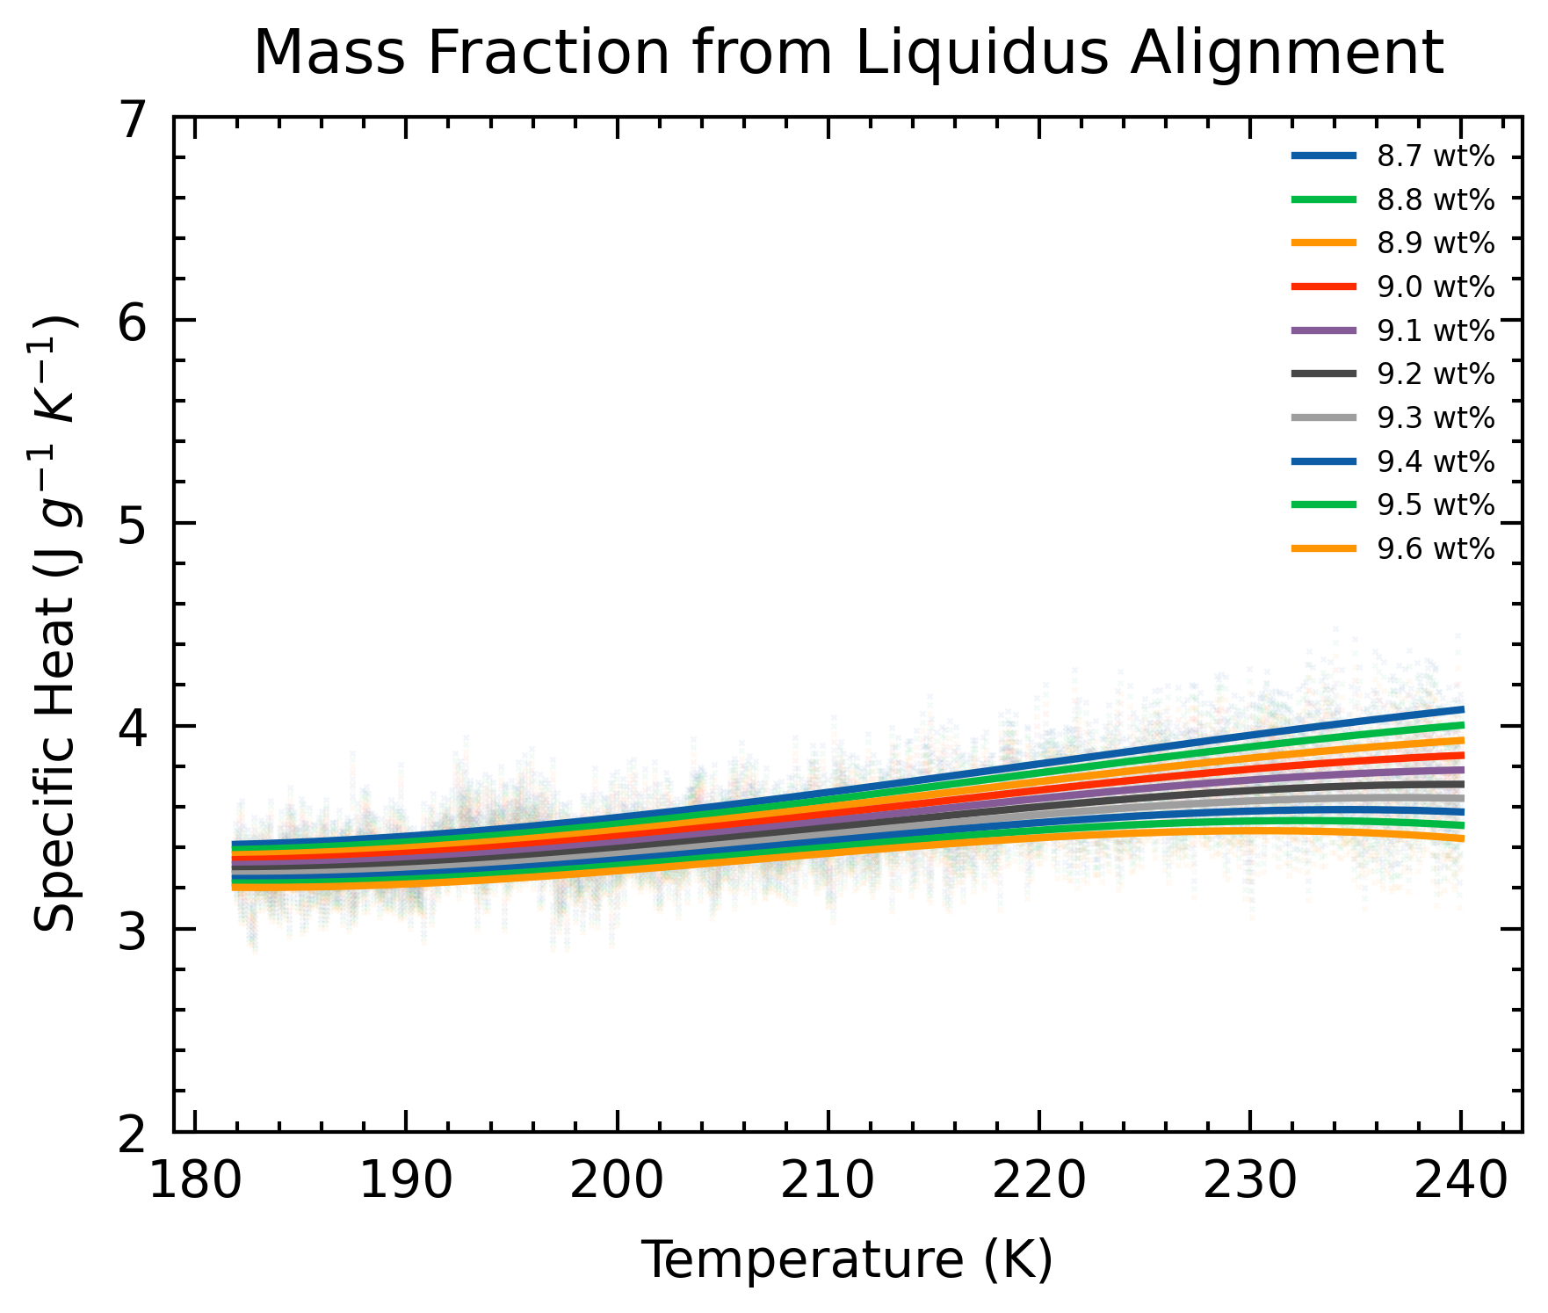
Recalculations
Effect of varying wt% (different samples)

Slide 13
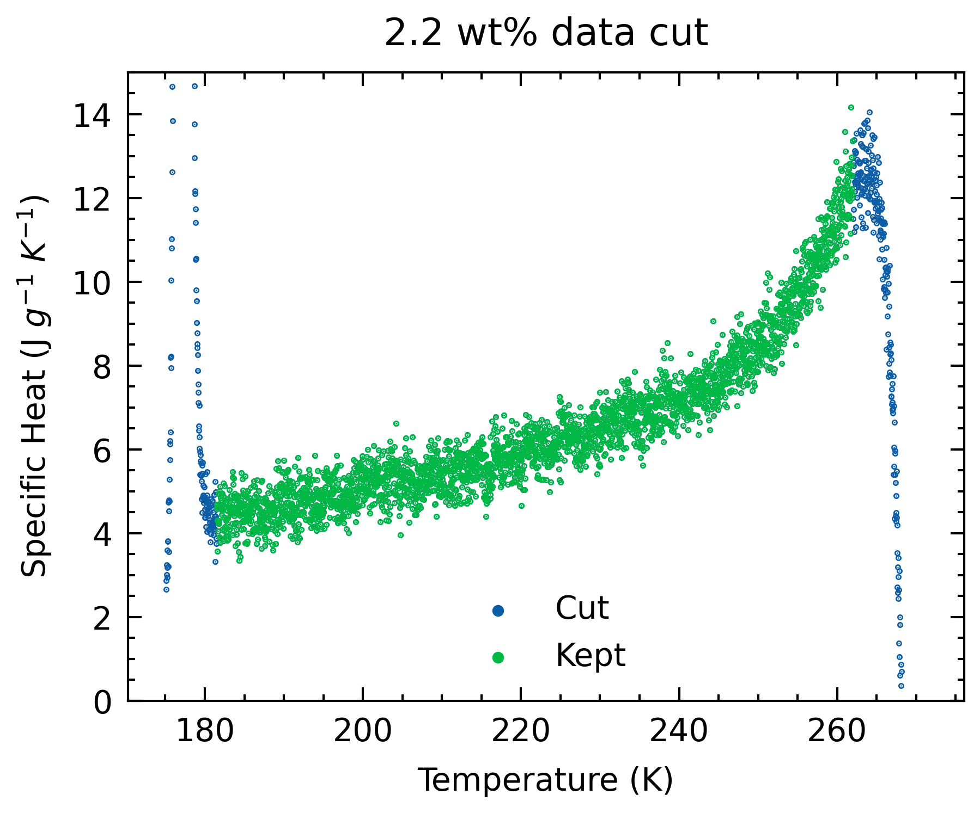
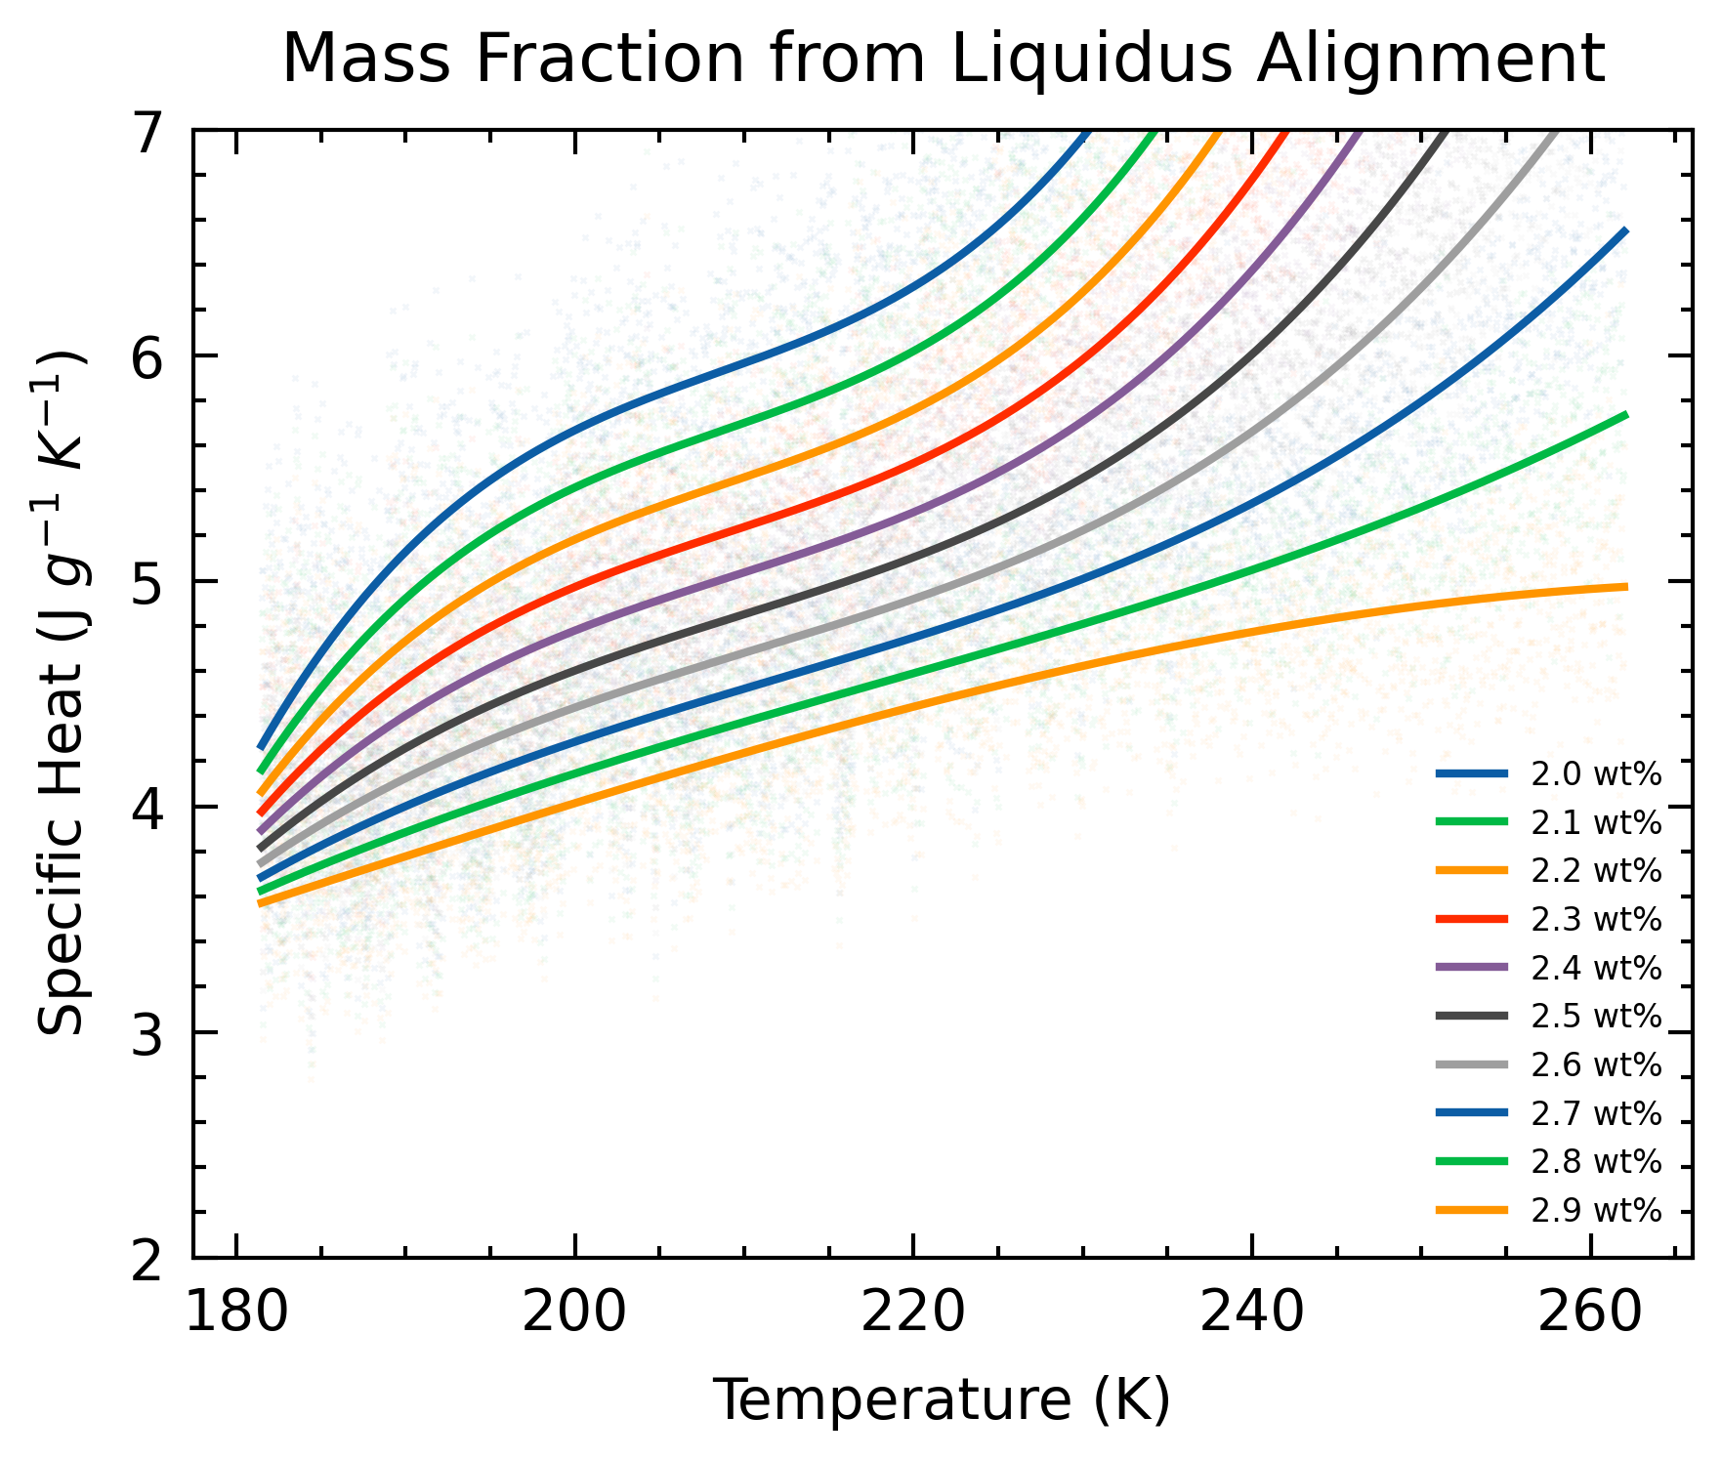
Recalculations
Effect of varying cutoff region

Slide 14
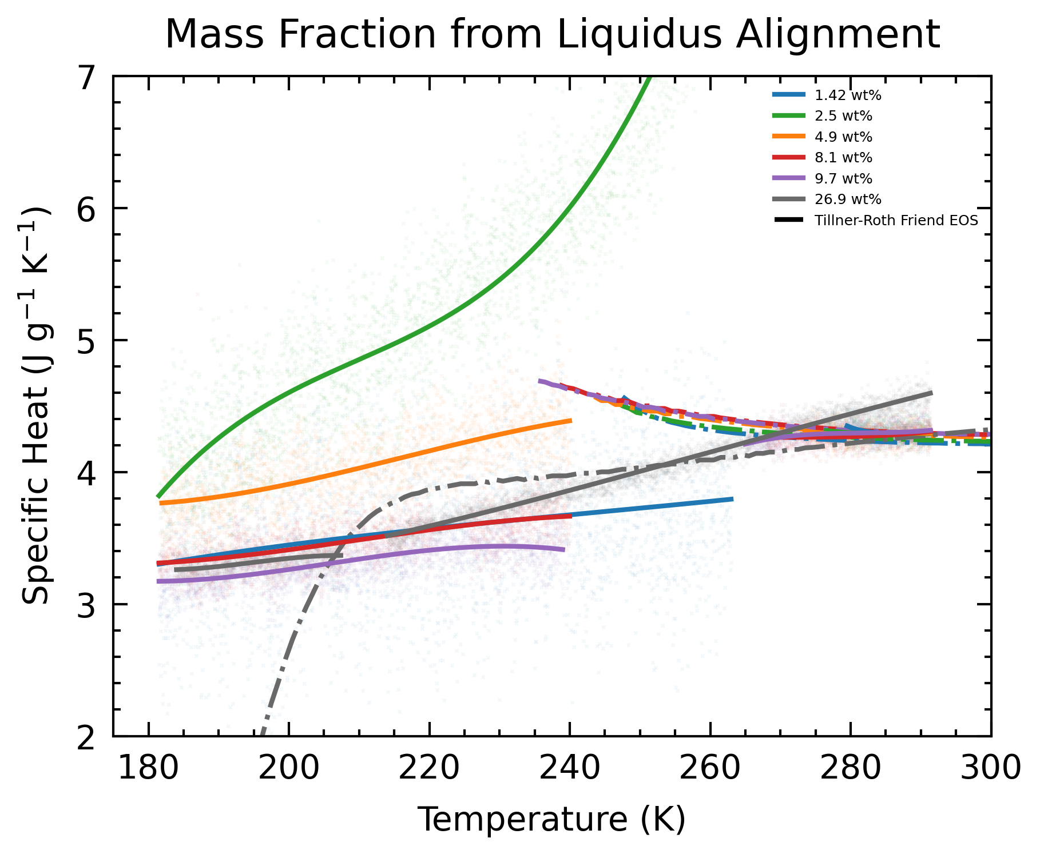
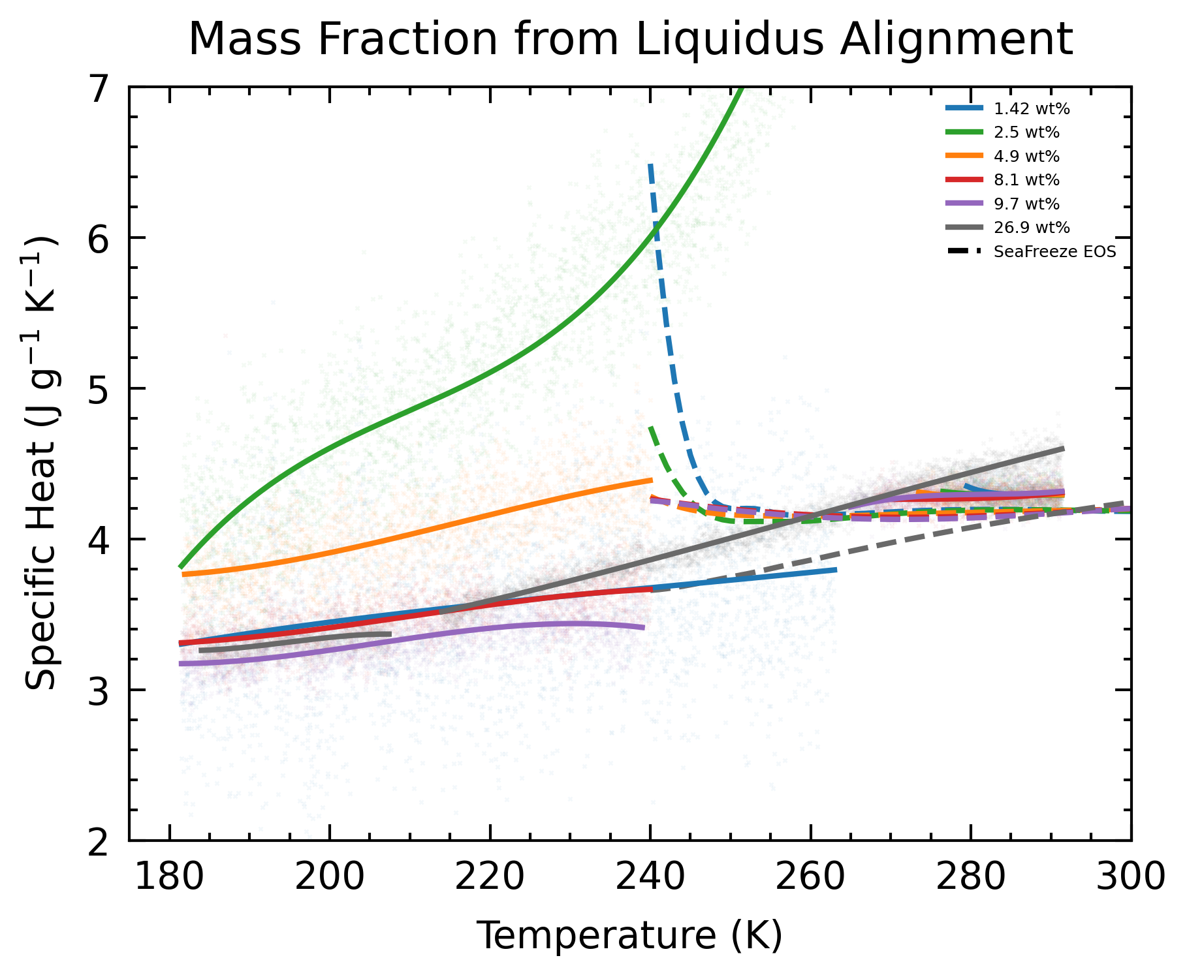
Comparing with EOS
Tillner-Roth and Friend / SeaFreeze EOS

Slide 15
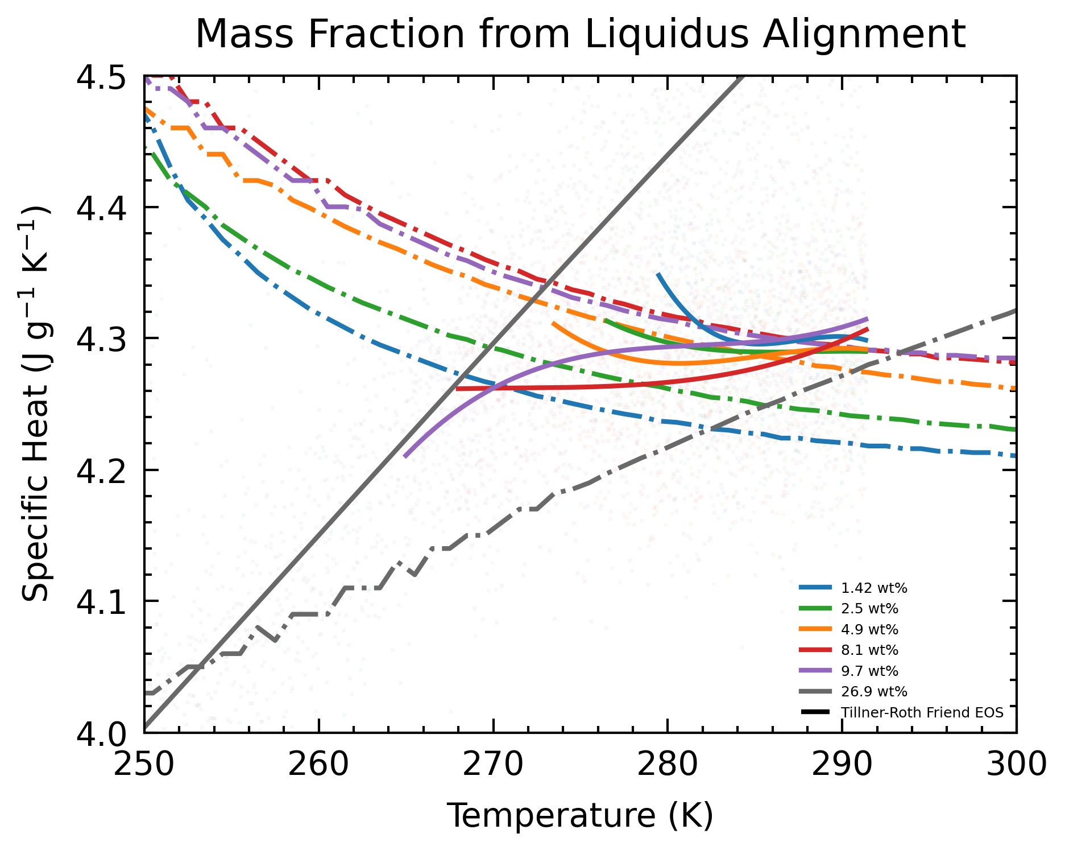
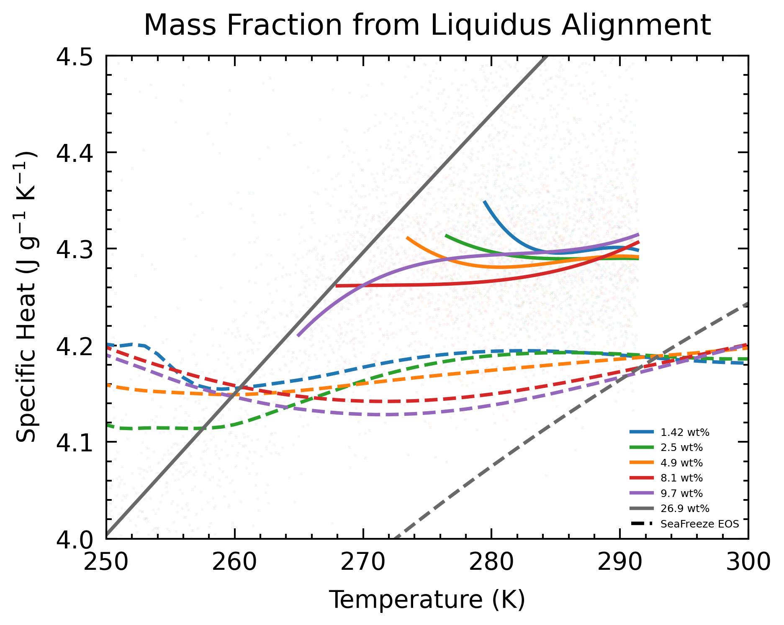
Comparing with EOS
Tillner-Roth and Friend / SeaFreeze EOS (Pure Phase)

Slide 16
Recalculations (conclusions)
At low wt%:
Greater spread of data
Greater sensitivity to wt%
Datapoint cut-off determines spline shape
Spline fit of the whole thermogram is not perfect: sometimes the max/min point is significantly out of line with that of the data
Moving forward, accurately determining wt% is a priority.
Method in choosing cut-off points would also be important.
If we expect the data of different samples to be similar, it can serve as a guiding constraint.

Slide 17
Recalculations (conclusions)
Moving forward, accurately determining wt% is a priority.
10 times sample mass measurement: determine errors due to preparation procedure
Caltech NMR: independent measure of the supply bottle wt%

Slide 18
Next steps
77 – 320 K, 0.1 K/min
20 wt% (done)
Blank
15 wt%
Periodicity extraction

Slide 19
Error Propagation
Mass of NH₄OH (mass balance) = 0.7889 ± 0.001 g
Some mass fluctuation at 0.0001 scale, thus I manually raised the uncertainty. (It increases density uncertainty by 0.001.
Volume of NH₄OH (pipette) = 1.000 ± 0.006 ml
Density of NH₄OH = 0.789 ± 0.006 g/ml
Mass Fraction of NH₃ = 1.42 – 8.7 ± 0.02 – 0.1 %
Molality of NH₃ = 0.85 – 5.6 ± 0.03 – 0.2
Temperature of Sample Error = 0.5 K (Muñoz-Iglesias et. al. 2018)

Slide 20
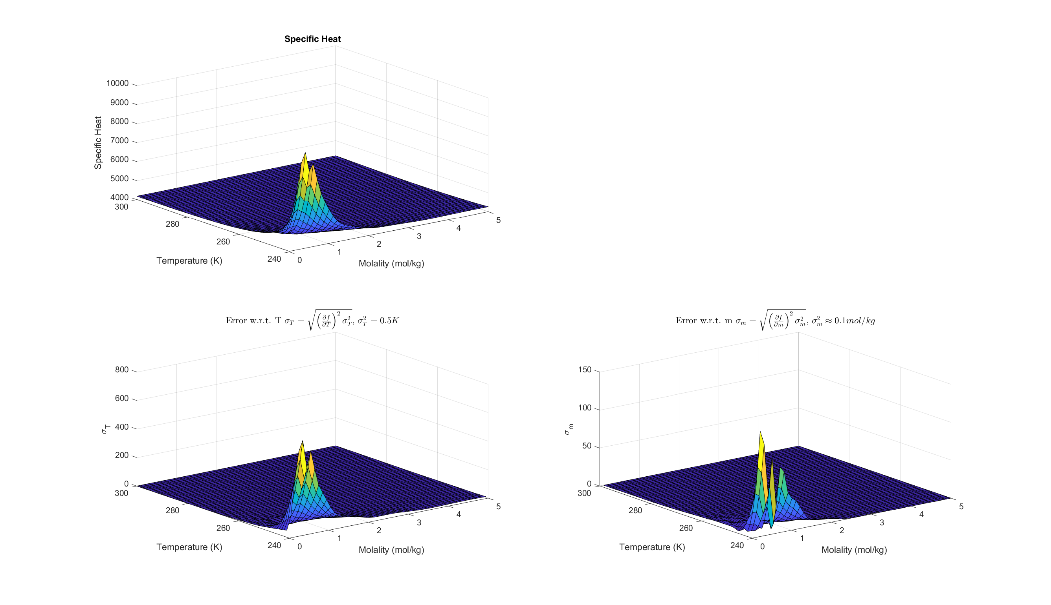
NH₃ EOS Errors (specific heat)
I assumed m in PTm inputs in Seafreeze corresponds to molality (mol/kg)
Rotatable .fig files attached in email
Are the following plots what is asked for?

Slide 21
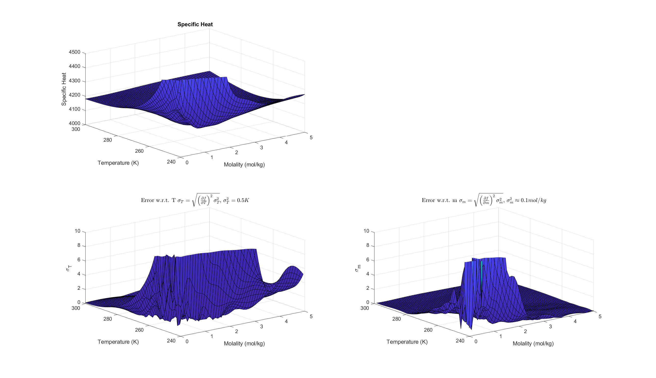
NH₃ EOS Errors (specific heat)
Zoomed in

Slide 22
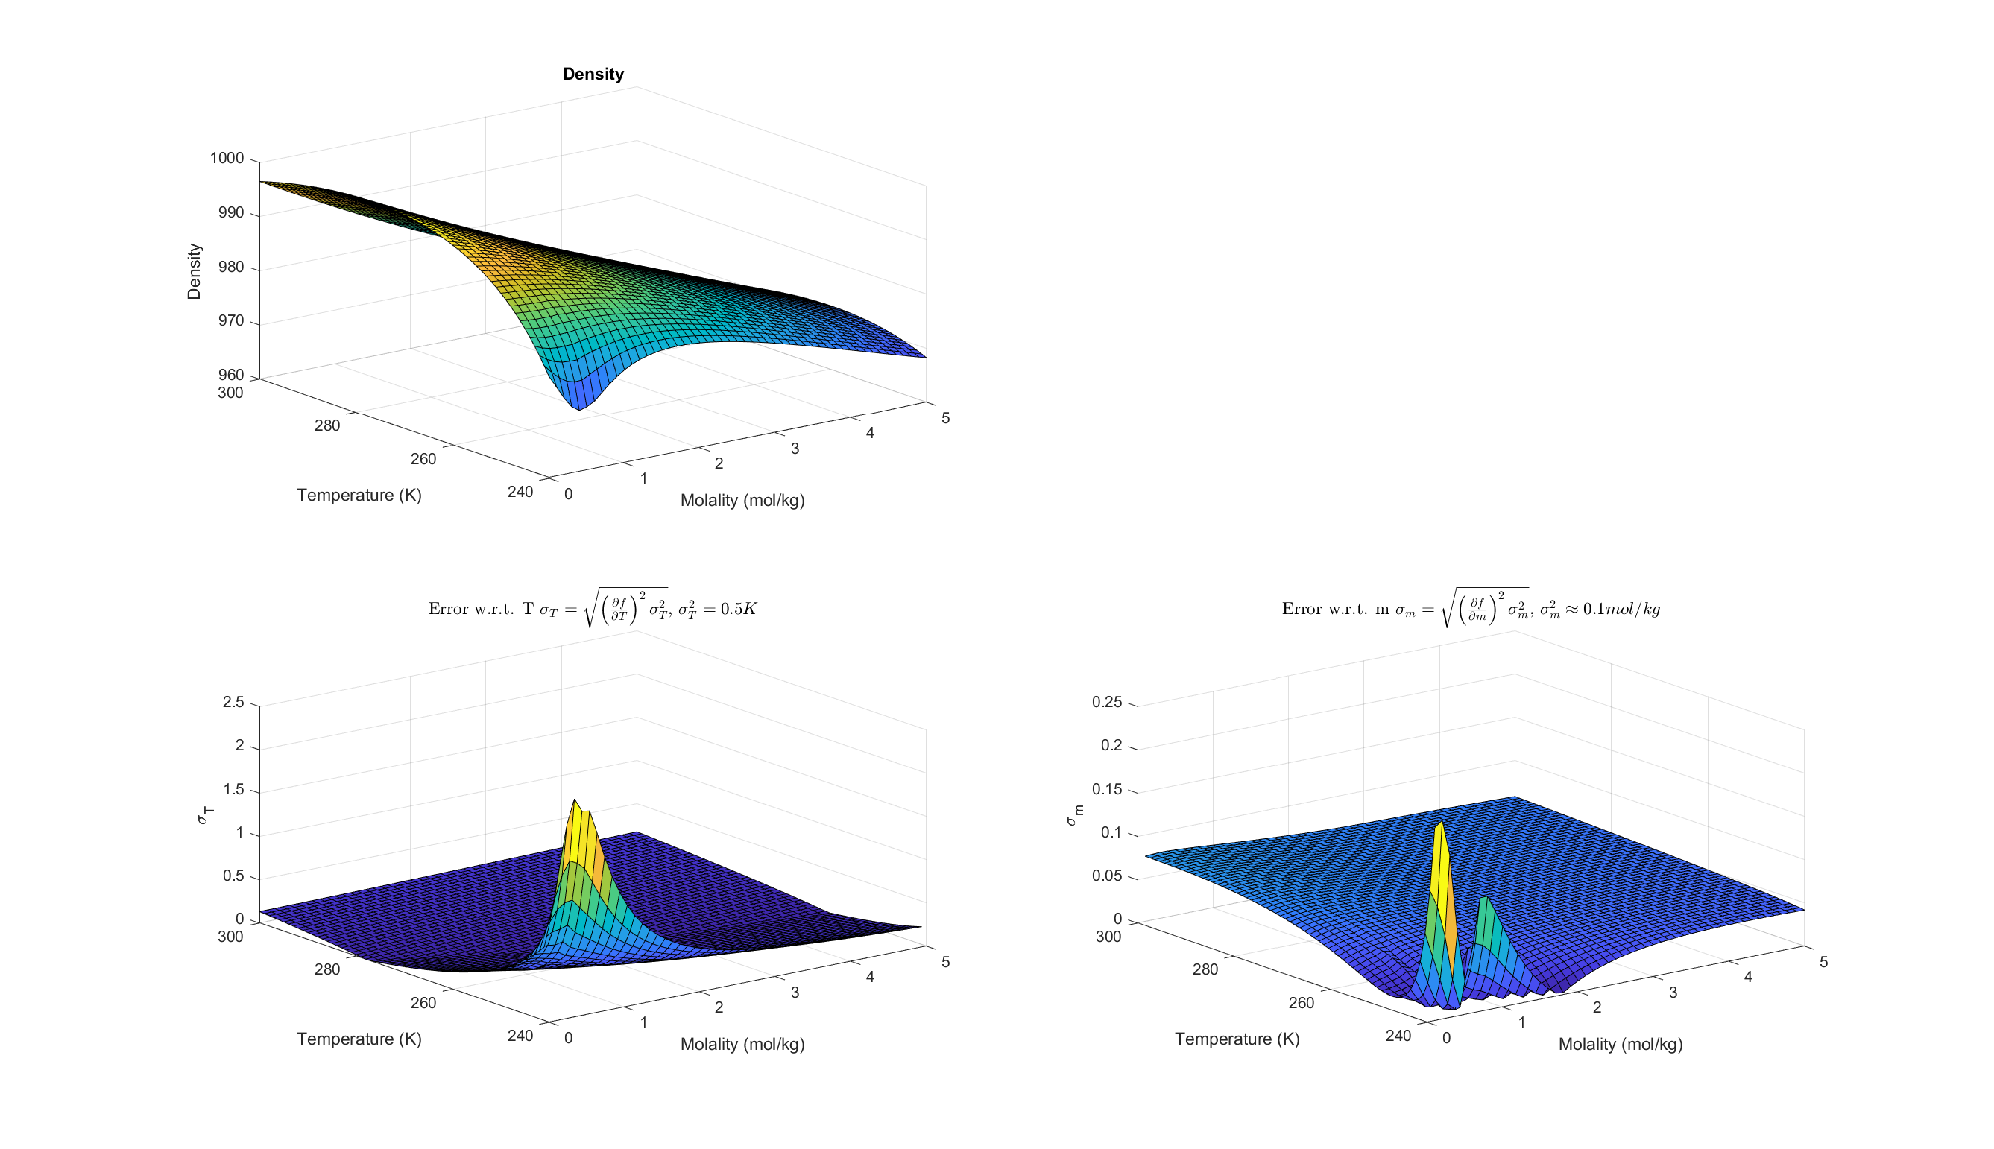
NH₃ EOS Errors (density)
I assumed m in PTm inputs in Seafreeze corresponds to molality (mol/kg)
Rotatable .fig files attached in email

Slide 23
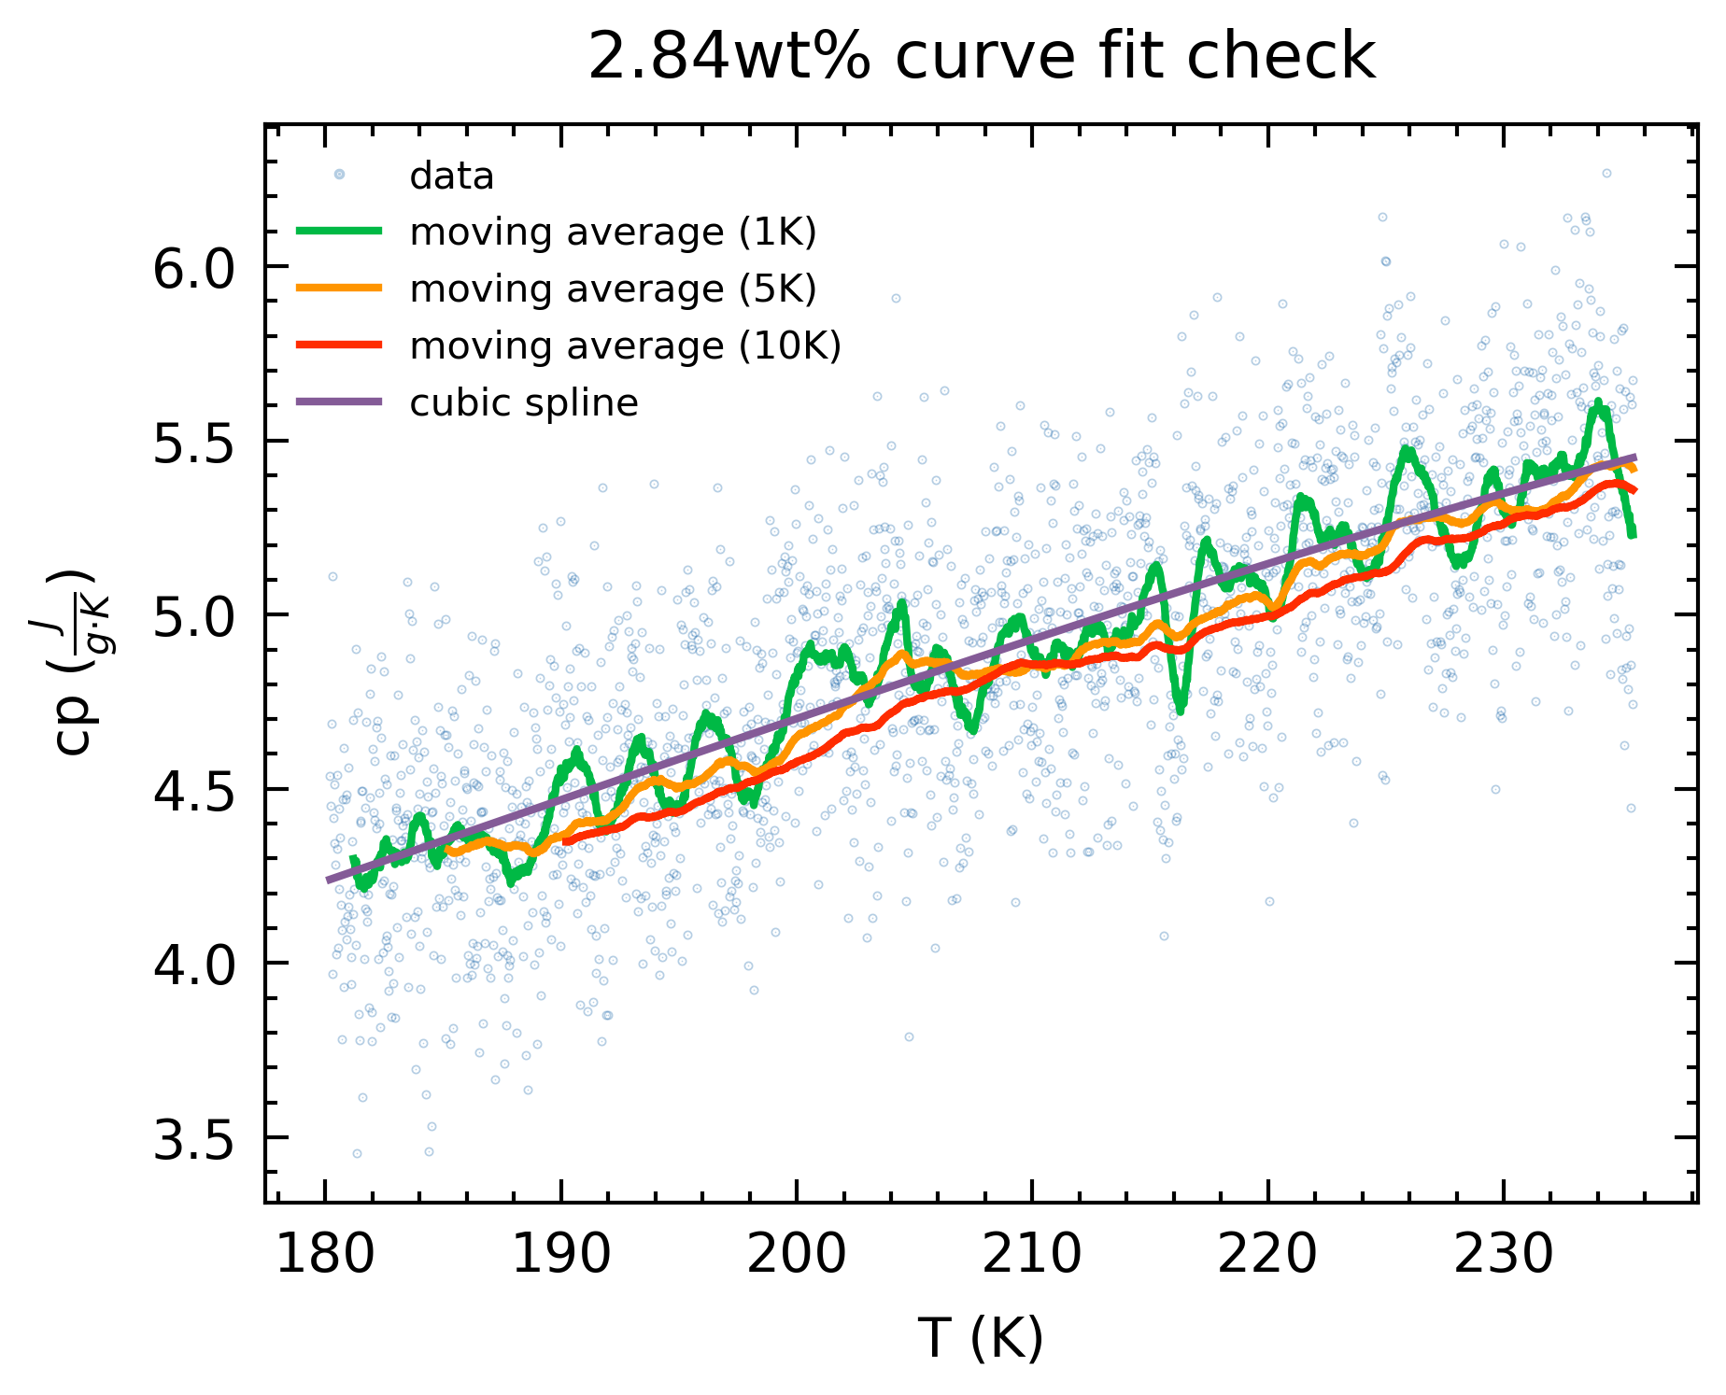
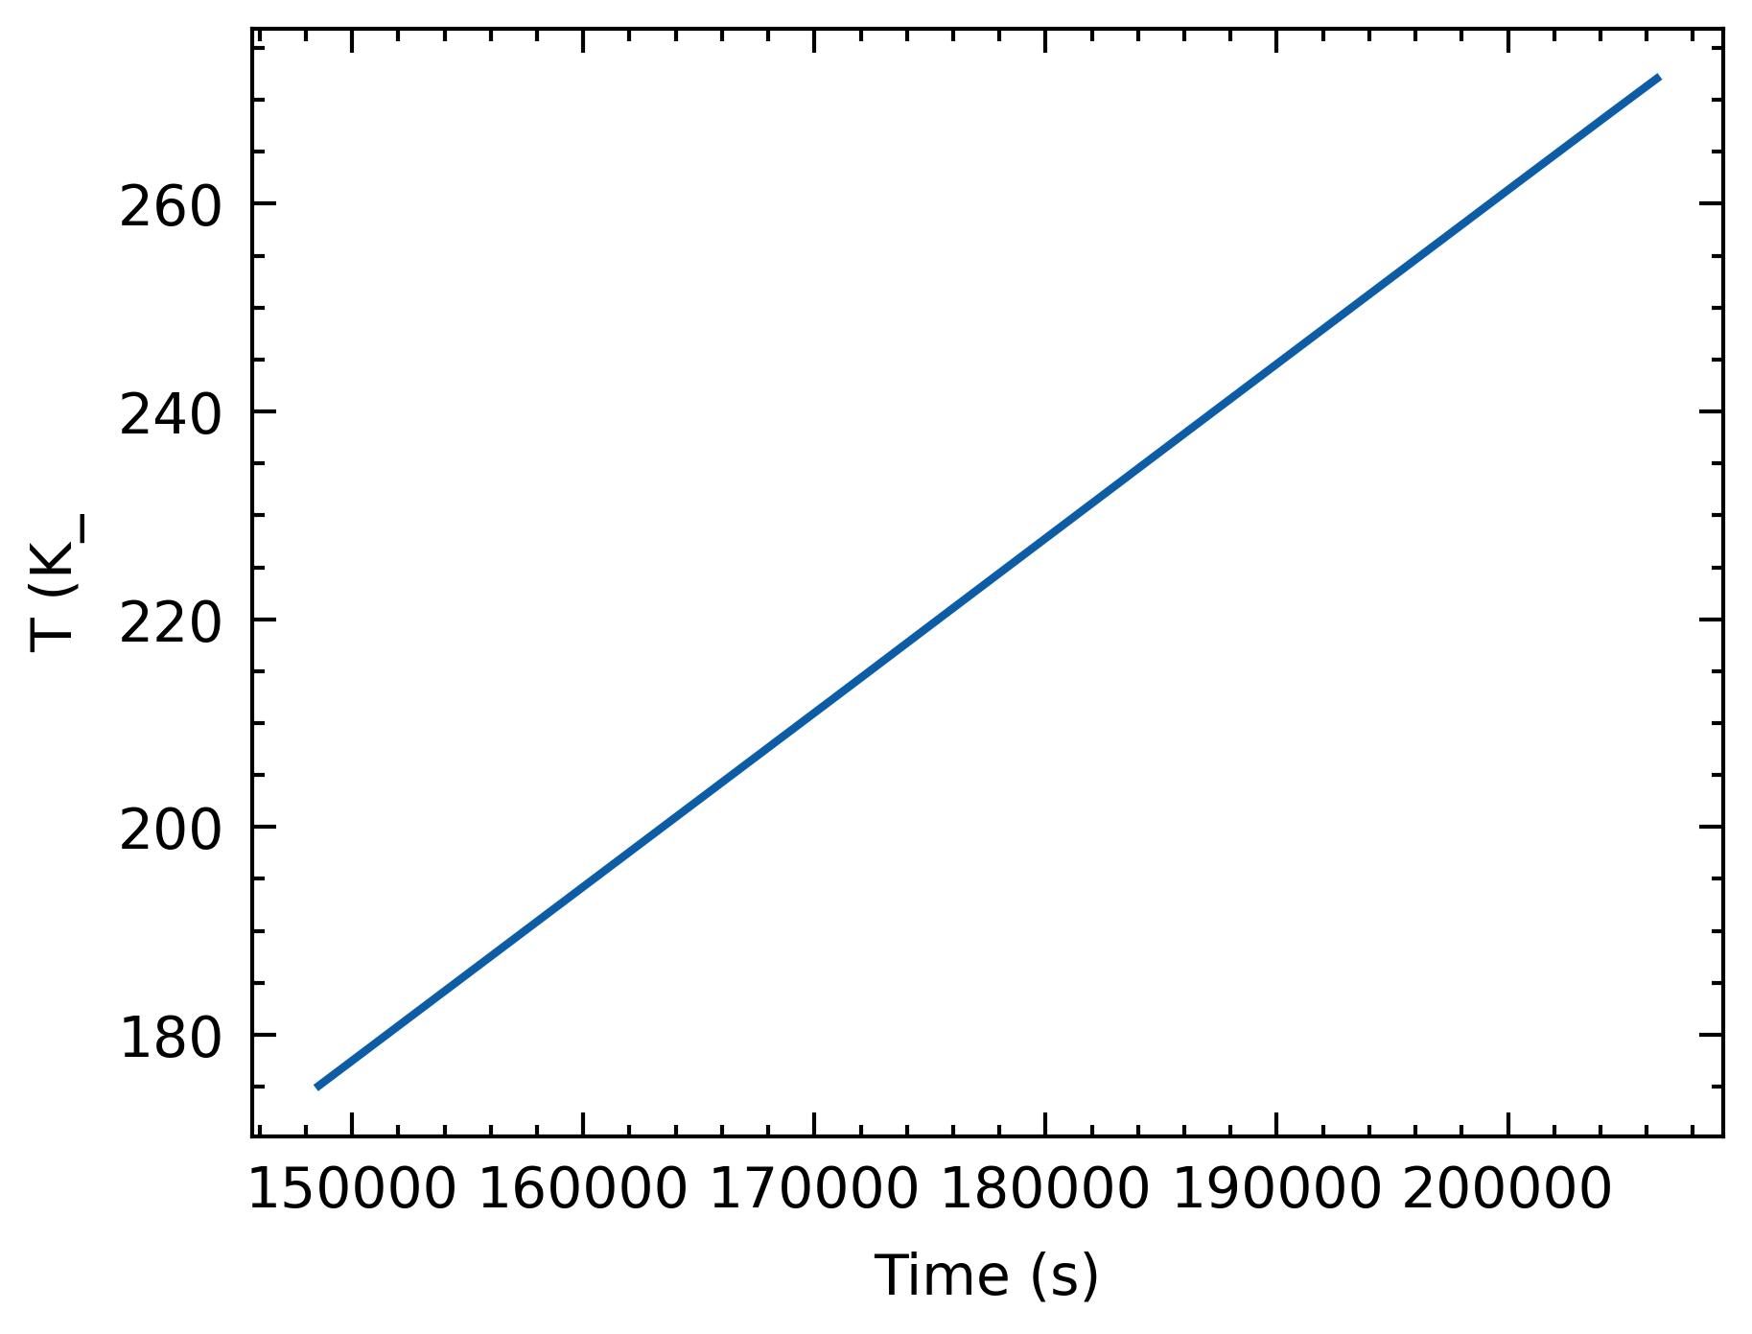
Moving averages & splines
Apparent periodicity in 1K bin moving average
Time and T are linearly proportional (interchangeable)

Slide 24
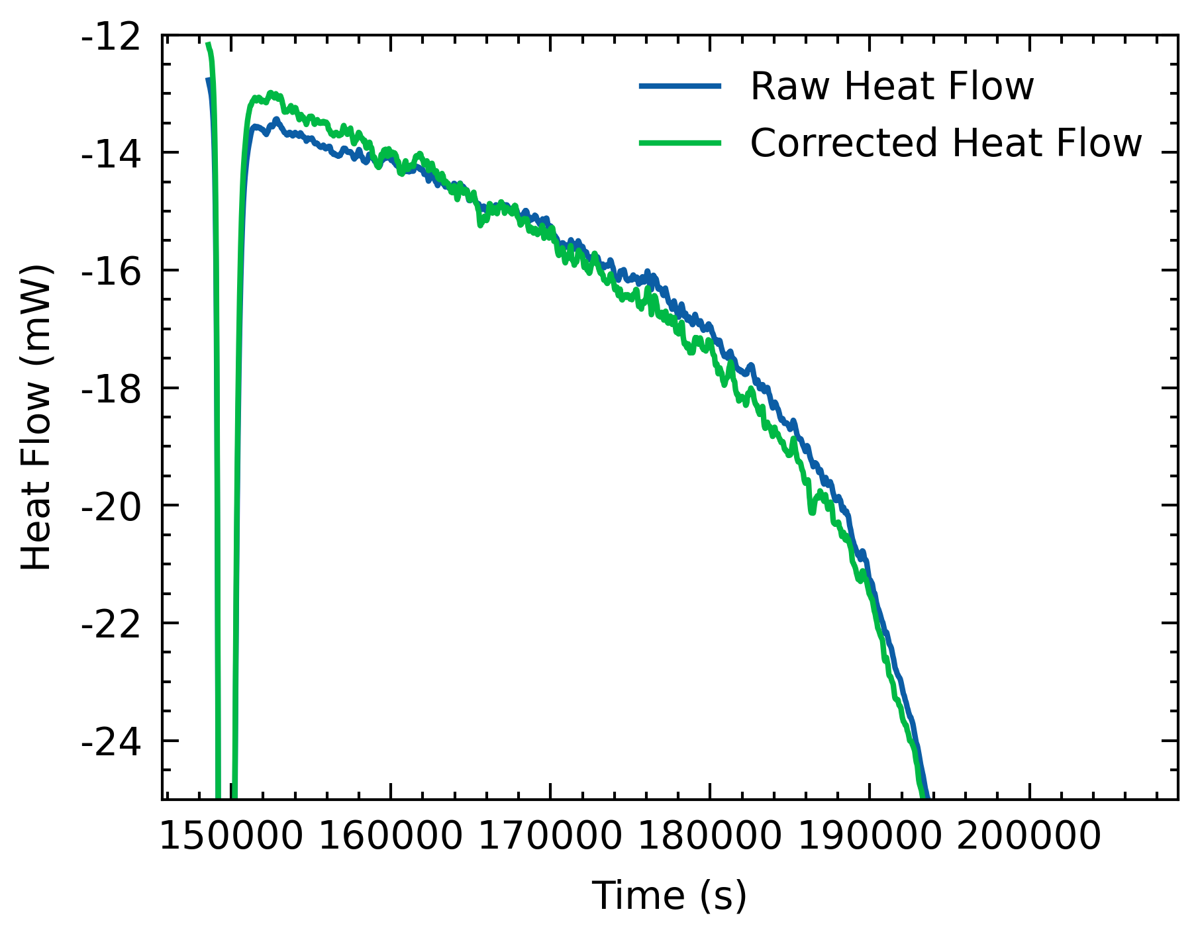
Moving averages & splines
Periodicity appears in heatflow (both in uncorrected and corrected)
Currently figuring out how to extract frequencies (FFT)

Slide 25
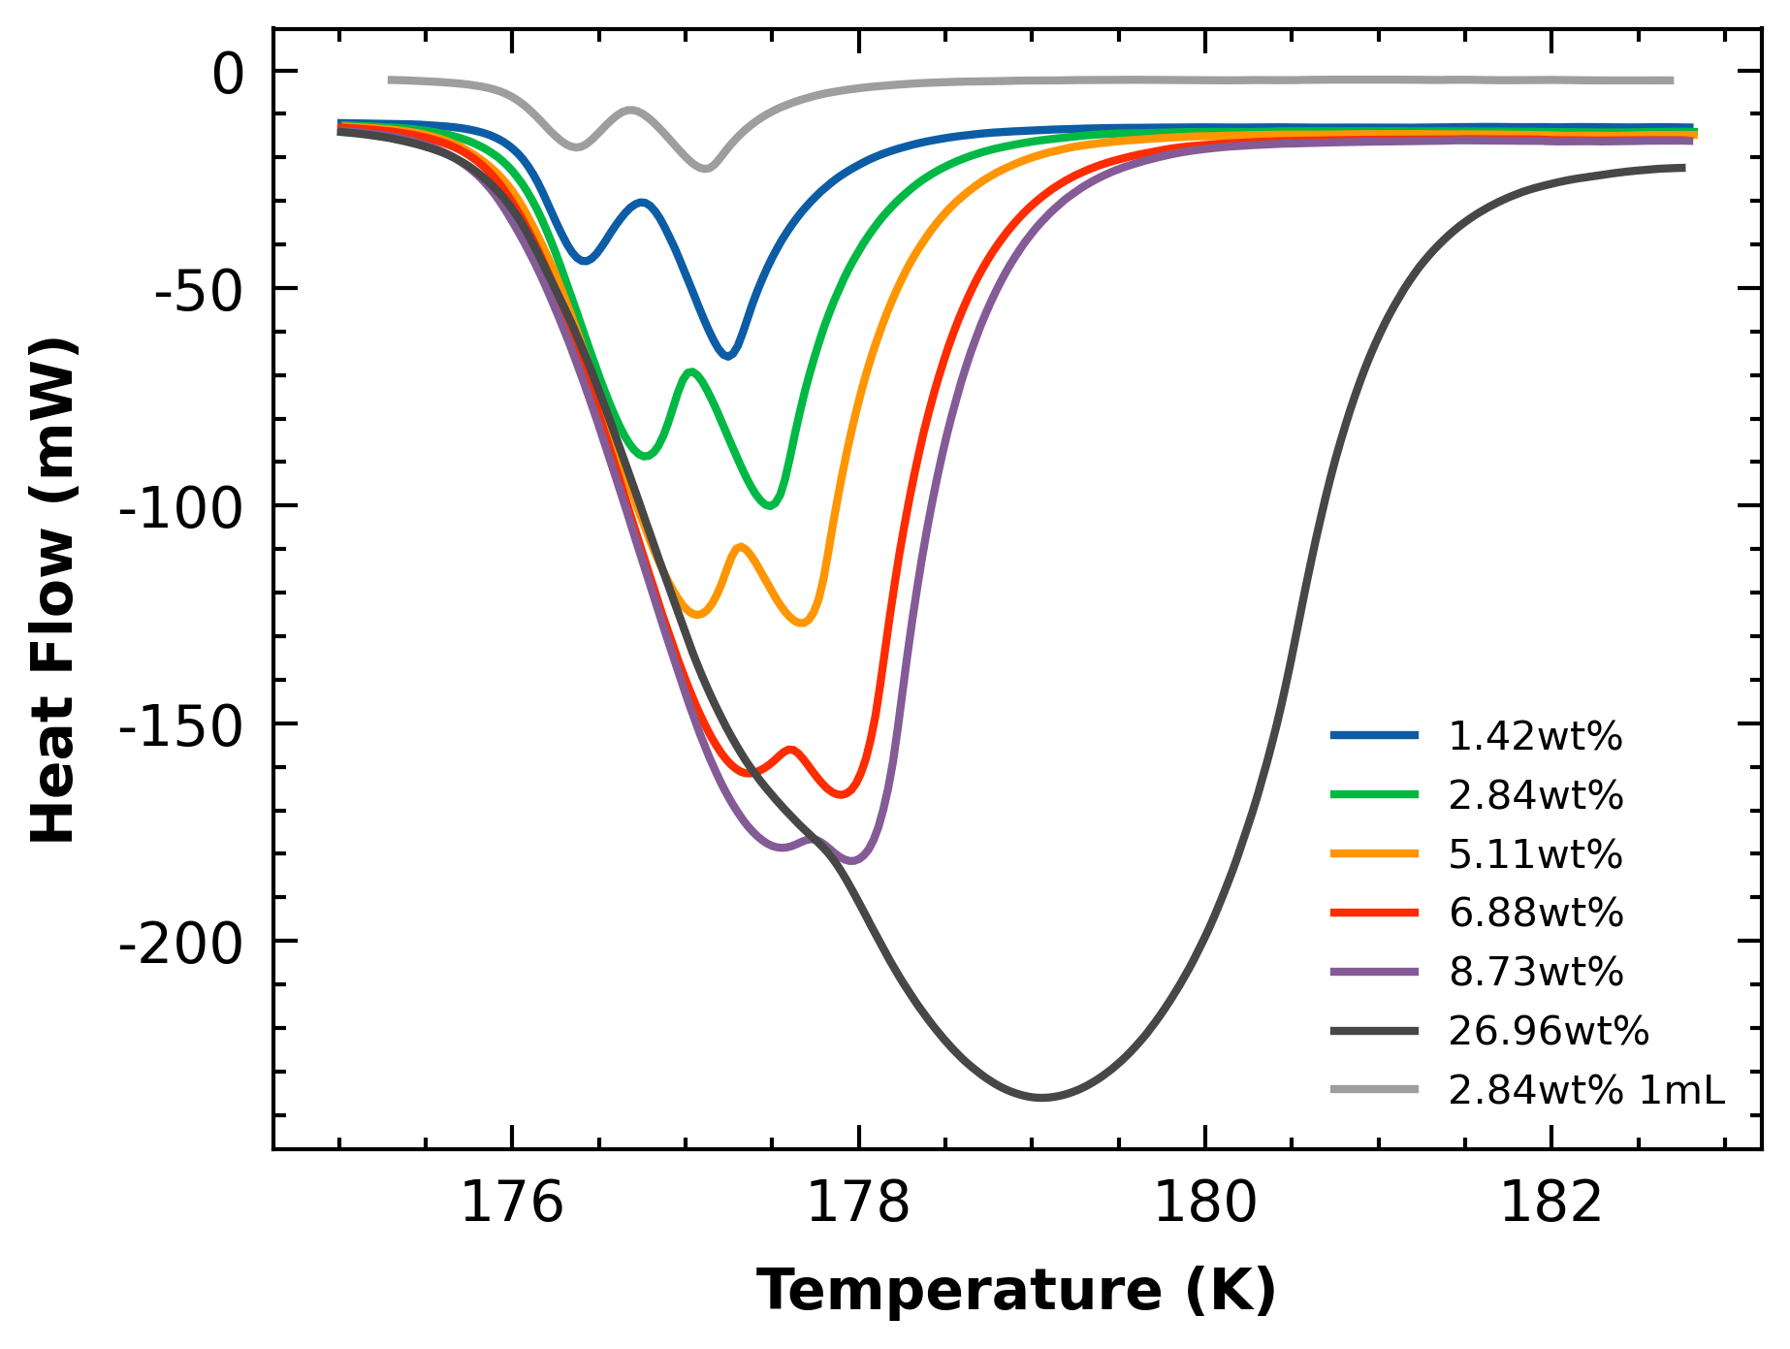
ADH Double peak
Seem to be an inverse function of amount of NH₃ present

